Slide 1
Methods and goals
METHODS:
Sampling of 240 1year old shoots (120 from own-rooted plant; and 120 from grafted ones)
2020
Biometric measures at shoot level (diameter, length, number of nodes) of 1 year old shoots (parent);
Qualitative measures at node level (type of bud/sylleptic (M= mixed, C=catkin, V=vegetative, B=blind) of the same 1 year old shoots
2021
Biometric measures at shoot level (diameter, length, number of nodes) of 1 year old shoots (child) born from the parerent;
Qualitative measures at node level (type of bud/sylleptic (M= mixed, C=catkin, V=vegetative, B=blind) of the same child shoots
GOALS:
The model of my dreams should answer those questions:
How 1 yeard old shoot is composed?
There are some zones of the same type of bud?
There are difference in composition according to the length of the shoot?
How is the behavior of lateral shoots?
How many of them developed?
Where?
From which bud? (vegetative or mixed?)
how can we deal with multiple buds and multiple lateral shoots per node?
This problems cold be solved analysing the data:
From different point of views
Shoot scale
Metamer scale
Bud scale
With different tecniques:
exploratory analysis
Glms/marcovian
WE WILL FOCUS JUST ON ON OWN-ROOTED PLANTS

Slide 2
Hazelnut architecture

Slide 3
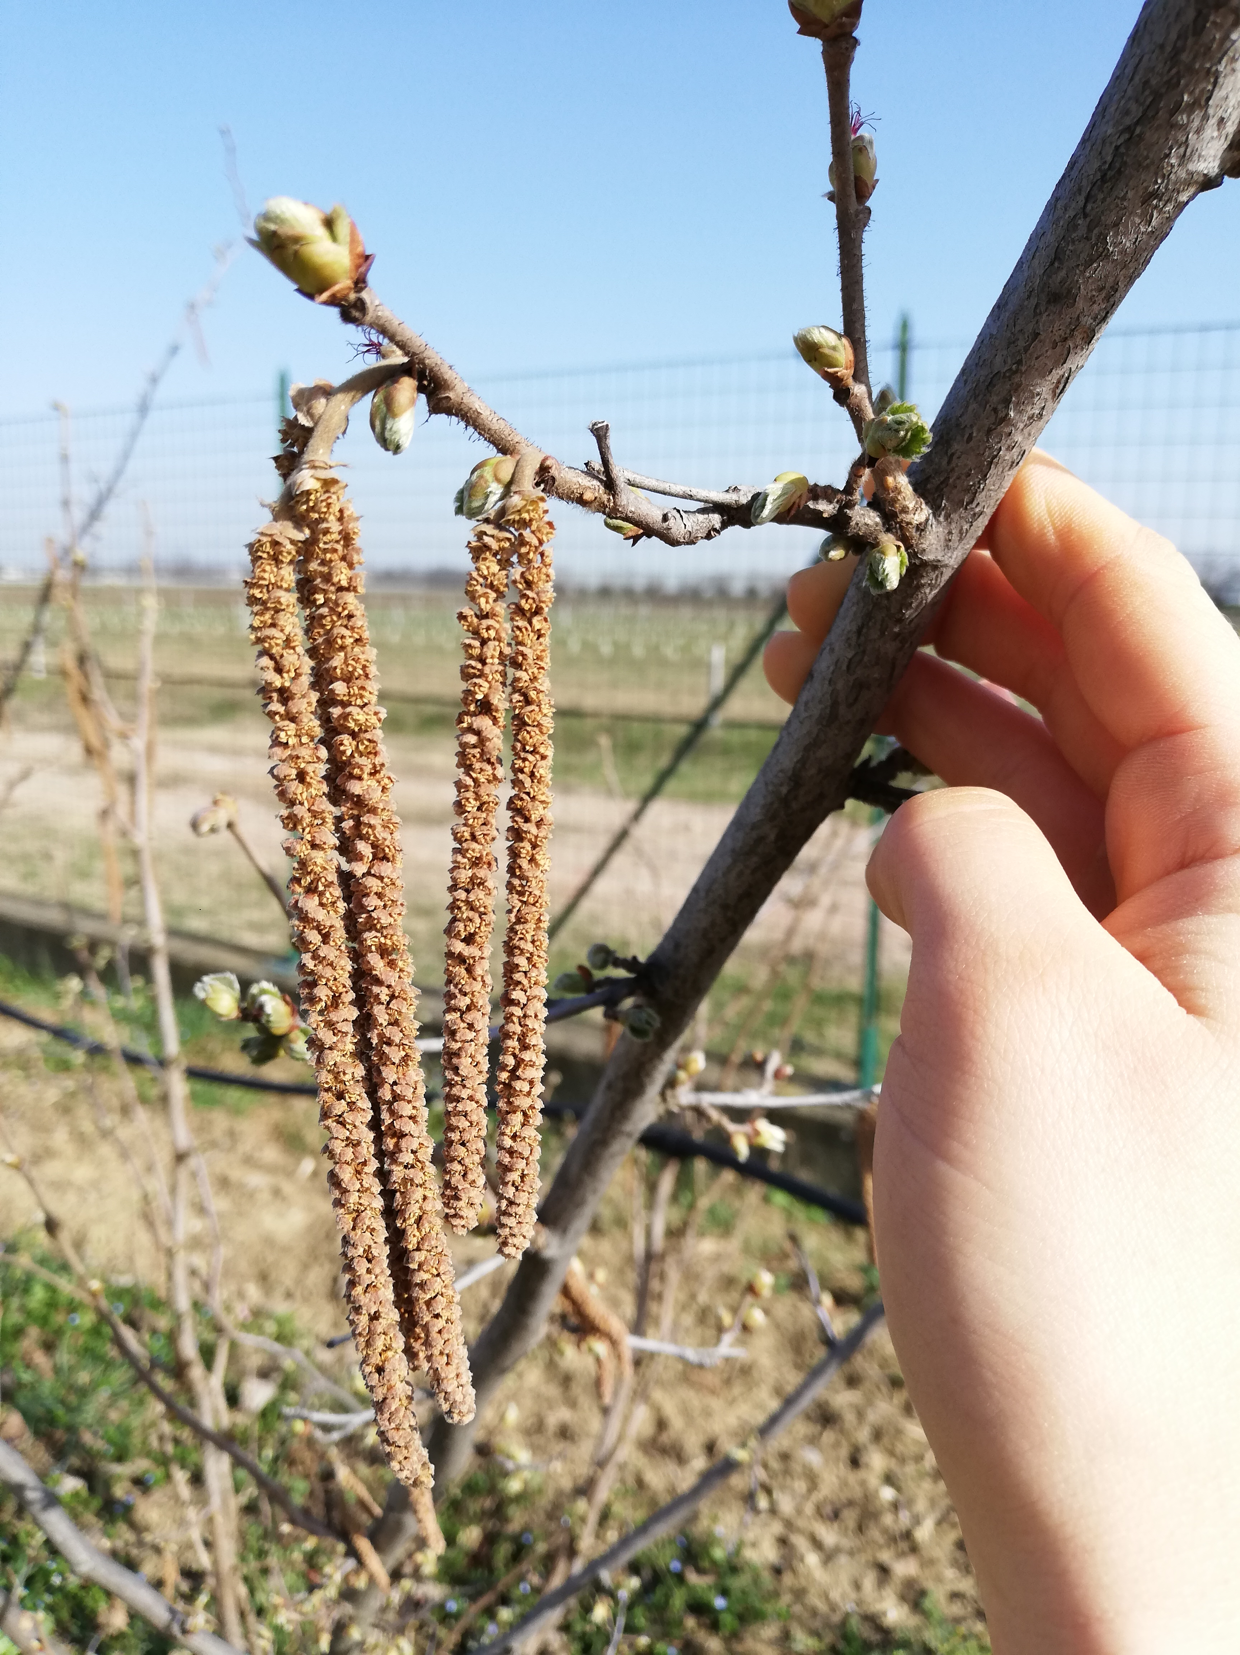
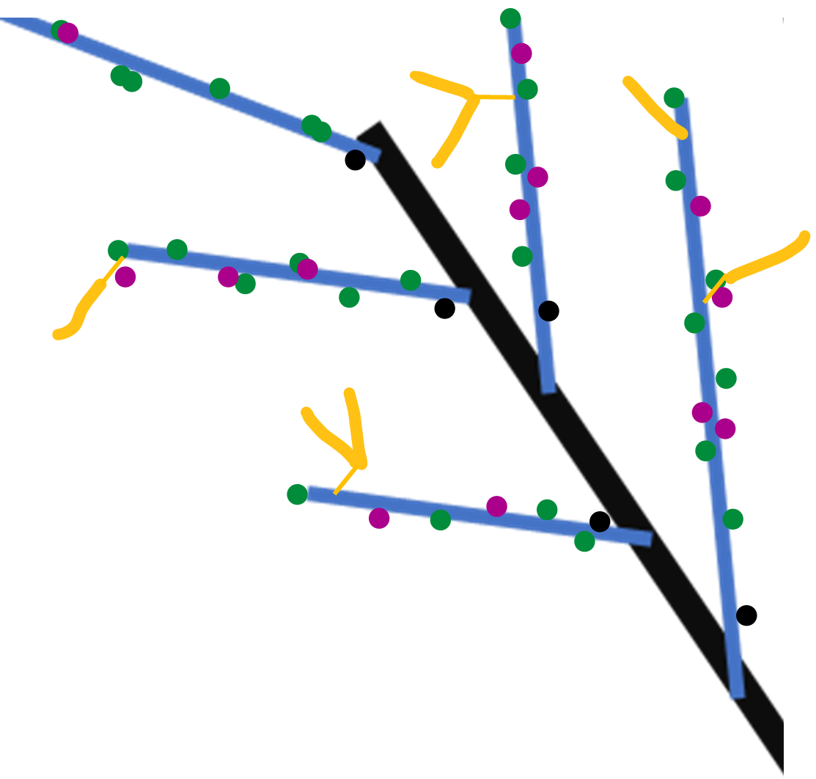
Winter observation
Year n
Year n
Proleptic shoot (referred to black)
Sylleptic shoot (referred to blue)
vegetative bud
Year n-1
Mixed bud
Blind node
catkin
SYLLEPTIC SHOOTS

Slide 4
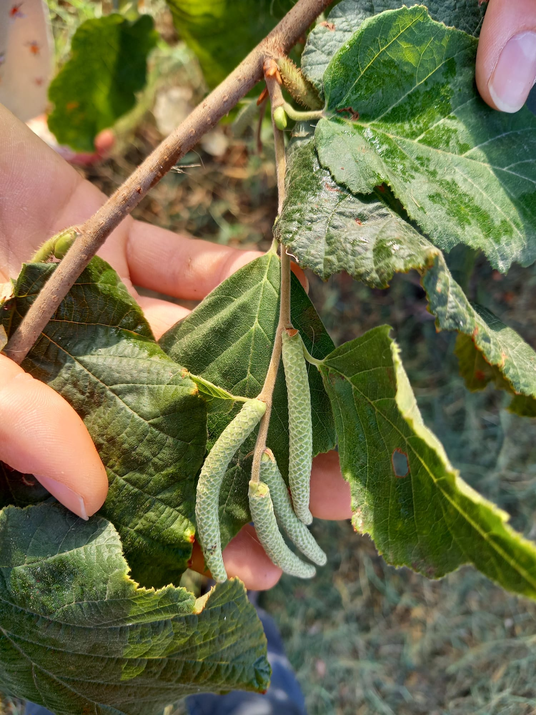
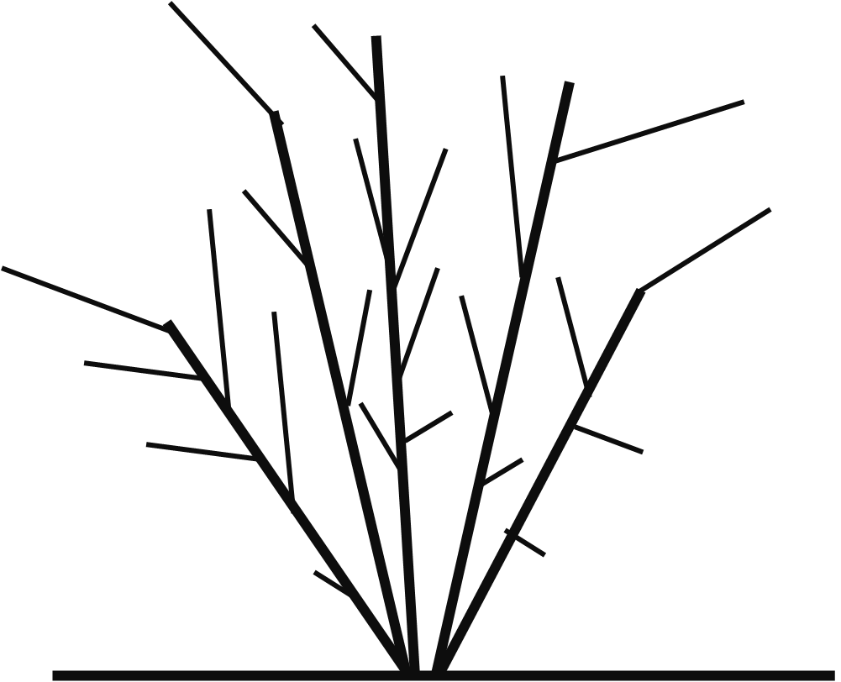
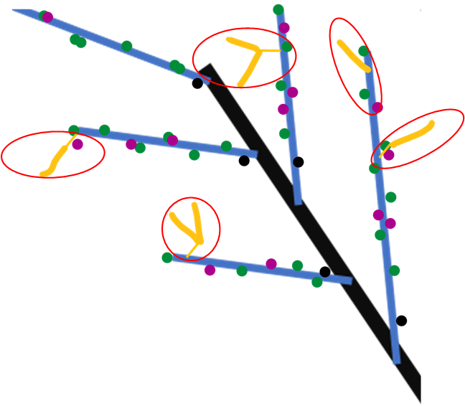

Spring growth
Year n+1
Year n+1
Year n
New proleptic shoot
Year n+1
Year n-1
New sylleptic shoot
Year n+1
leaves
SYLLEPTIC SHOOTS

Slide 5
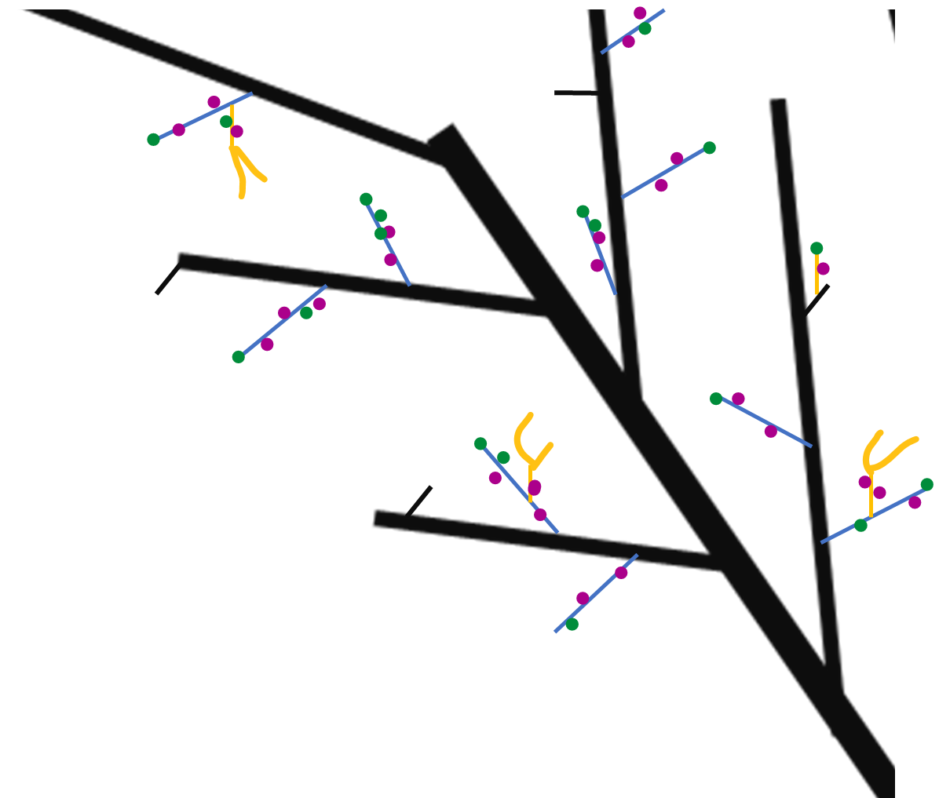
Next winter observations
Year n
Year n
Year n+1
Proleptic shoot
Year n+1
Sylleptic shoot
vegetative bud
Mixed bud
Year n-1
Blind node
catkin
SYLLEPTIC SHOOTS

Slide 6
GLMs
Markovian models
They are used to understand if a predictor describes a variable
Poisson if the variable is quantitative;
Binomial if the variable is categorical
Es. Is Vegetative bud burst (Y) depending on (~) length, rank node, sibling M, sibling V, tot buds at that rank?
They are used to understand if the variables (buds) can be grouped into homogeneus zones.
HAZELNUT ISSUES:
Dependencies between rank nodes;
Dependencies between buds at the same rank
NB_i glm sono delle generalizzazioni dei modelli lineari. Ipotizzando che le variabili possano essere distribuite anche in altri modi rispetto alla distribuzione normale

Slide 7
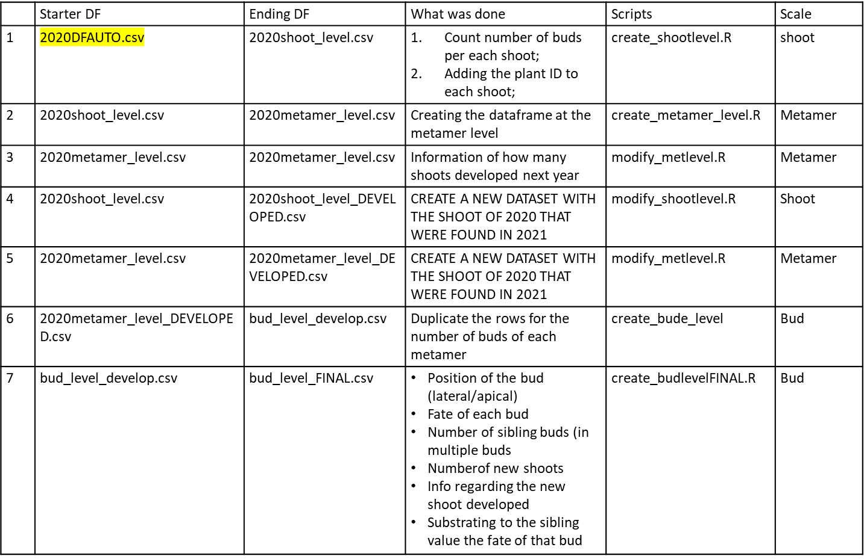
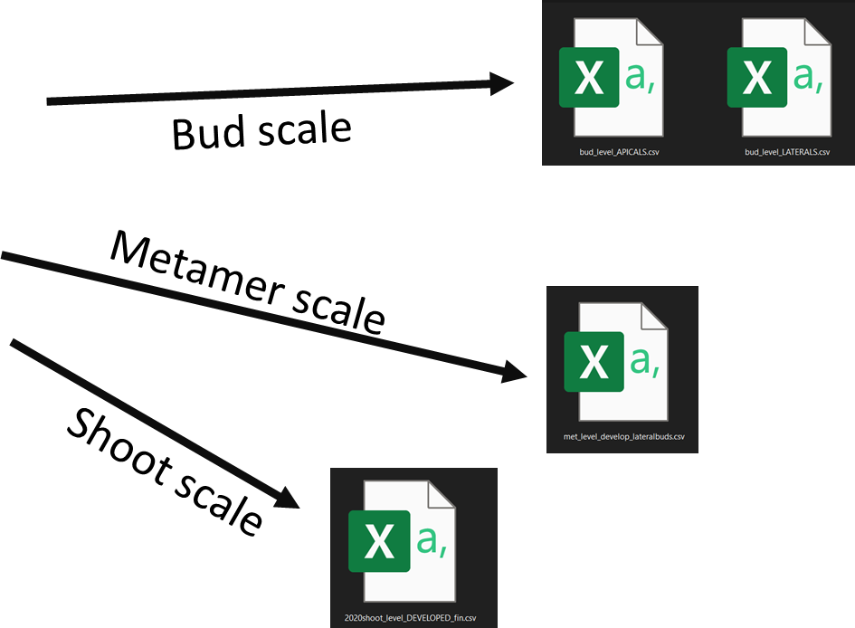
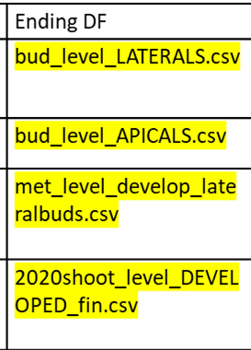
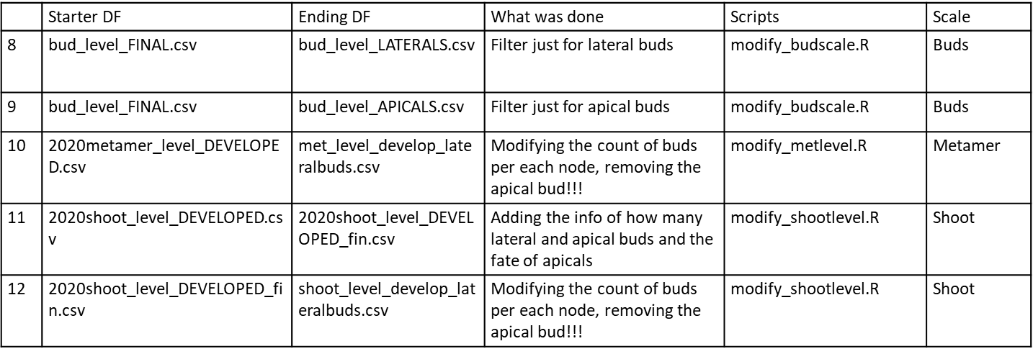
DATASET_ARCHITECTURE HAZELNUT
Process
OWN-ROOTED e INNE

Slide 8

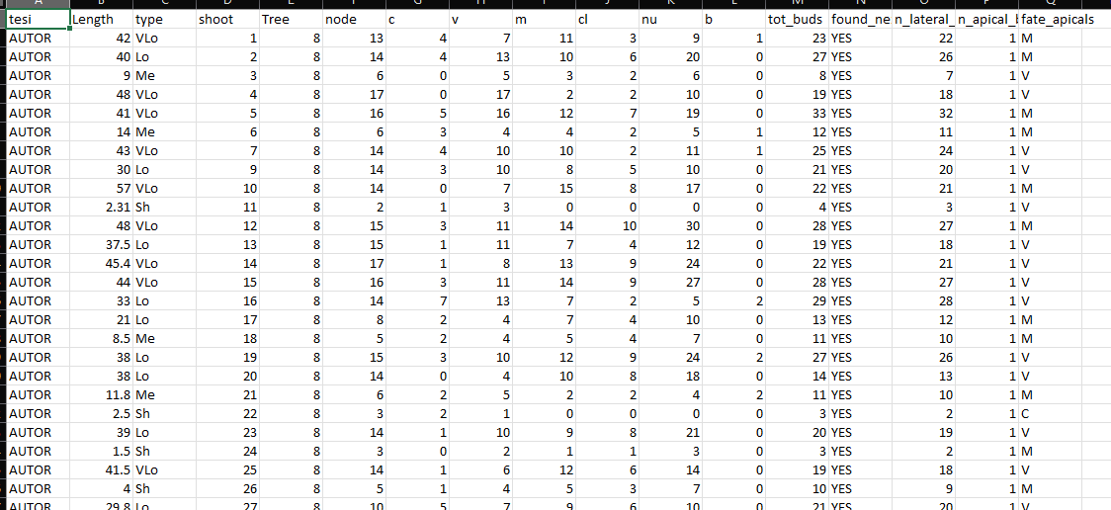

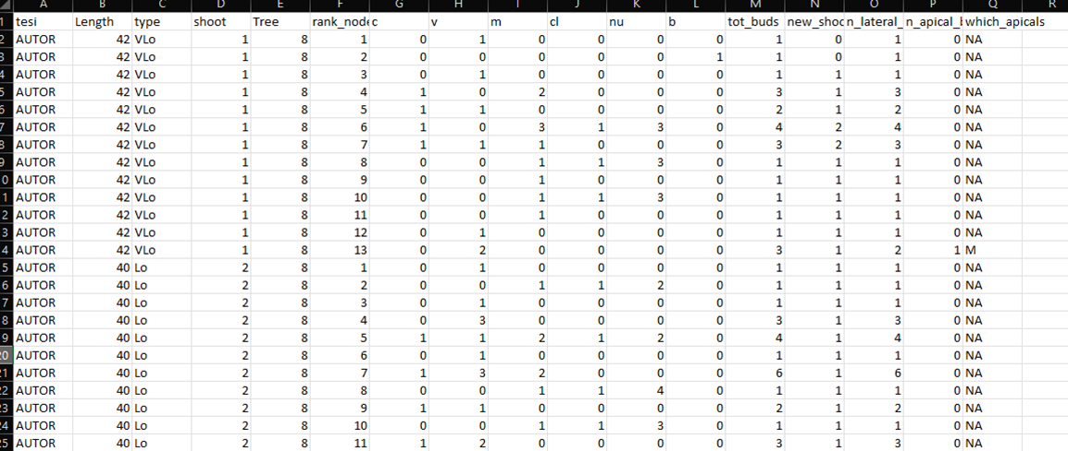
Shoot scale
Description of each shoot composition in terms of:
row ID
Not grafted
Plant ID mother of the shoot
Length(cm);
Length(class);
Number of nodes;
Number of buds per type (C,V,M,B);
Number of clusters;
Number of nuts;
Bud scale
Description of each bud composition in terms of:
New shoot ID
Year of parent sampling
Shoot ID
Shoot length(cm);
Metamer ID
Number of sibling buds at the same node(C,V,M,B);
Total buds per node;
Number of Shoots developed at that rank;
Fate of bud (one per each row)
Position of the bud (apical/lateral)
Length of new shoot(cm)
Length of new shoot(class)
Information regarding each new shoot composition

Slide 9
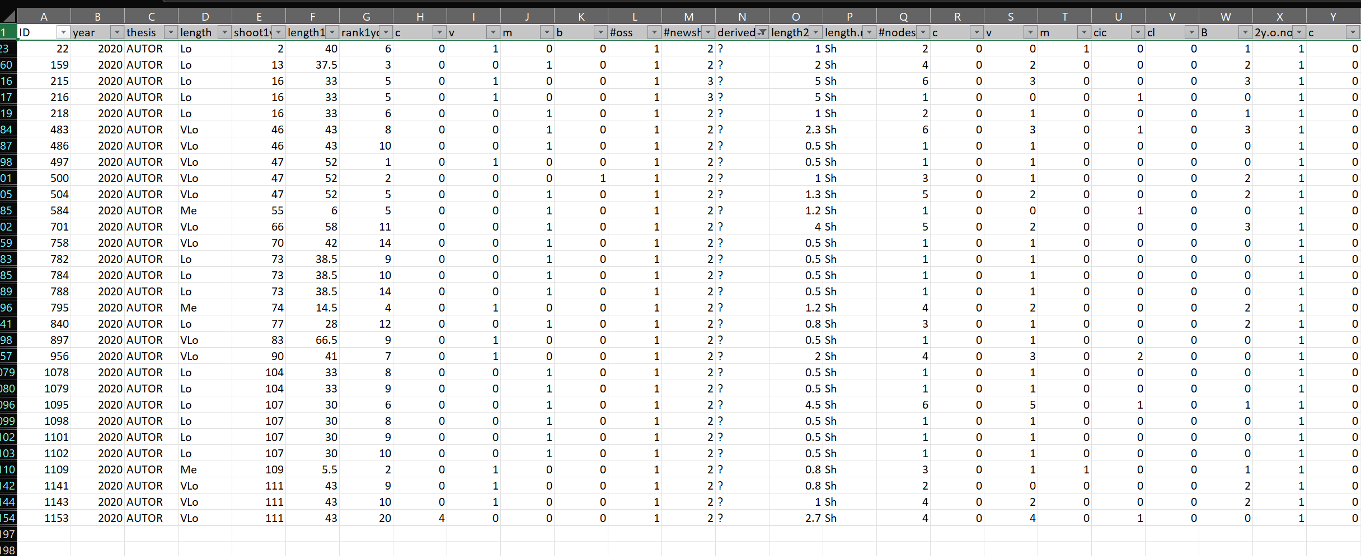
The original «new_shoots» file has the same information of the bud fate scale(in terms of new shoots details) plus it contains some the errors.
Errors= new shoots that i can’t explain from where they came from. Assigned as «?»
These errors impact less than 3% on the totals, so i guess we can ignore them and use the bud_scale file also for new shoots. What do you thing?

Slide 10
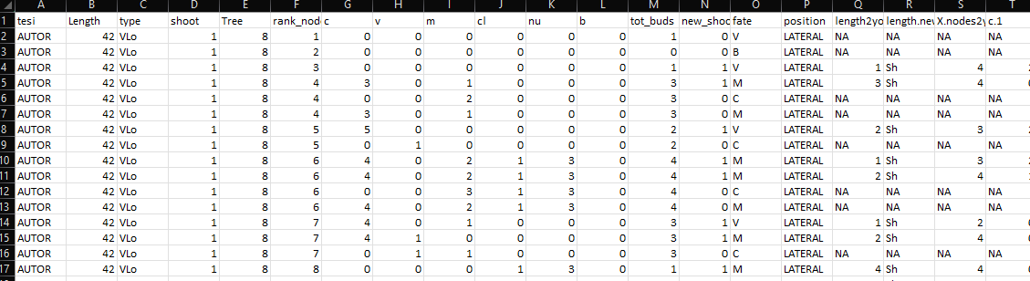
GLMs example
glm(Y~F1+F2+F3+F4+F5+F6+F7, family=«binomial»)
PREDICTORS
Two GLMs:
For fate=V
For fate=M
F1
F2
F3
F4
F5
F6
F7
Y
How to Interpret glm Output in R (With Example) - Statology

Slide 11
Problems & solutions
Several predictors mask their effects (ES. NA values)
Run different GLMs avoid each time a predictor:
Y~tot_buds+length+rank
Y~M+V+C+length+rank
p. Value are significant because we have many data. Is real significance?
Permutation models + difference in AIC

Slide 12
Permutation models
RM=GLMS(Y~A+B+C, data=DF)
Shows that A is really significant (***).
To be more sure that it is really significant, it necessary to do permutation models.
LOGIC:
the AIC of real model (RM= Y~A+B+C) should be LOWER (better) than the null model (NM= Y~B+C+1).
Compute RM-NM=q? YES (q should be <0)
But it could be a casuality. We have to permute A (shuffled) 10000 run again RM_shuf=(Y~A(shuffled)+B+C)
RM_shuf-NM=t
how many times t<q??. If t is < q it means that RM_shuf better explain the model!!!
If t<q in 0.01% of the permuted trials (significance = 1%) we can conclude that A has an effect on Y!!

Slide 13
Make GLMs
ADDING METHOD
Find dipendent variable (Y) and predictor (A). NB_start with 1 predictor and if it is significant, add the others.
Run the model glm(Y~A)
Is A significant?
No. → Stop. Try another predictor (B);
Yes. → permutation model cofirm?
Find another predictor (B);
Run the glm (Y~A+B)
Is B significant?
No. → stop. Try with another predictor (C);
Yes→permutation model cofirm?
Continue like this with all predictors

Slide 14
Make GLMs
SUBTRACTING METHOD
Find dipendent variable (Y) and predictors (A,B,C). NB_start with ALL predictorS and DISCARD THE LESS SIGNIFICANT USING THE PERMUTATIONS MODEL AND P-VALUE OF GLMS
Run the model glm(Y~A+B+C)
Exclude the predictor less significant
Try different combinations (Y~A+B; Y~A+C, Y~B+C)
An alternative way is to use the function step() with glm. It will automatically check the predictor with lower AIC (step function – Rdocumentation) tutorial in : 2101f11StepwiseLogisticR (toronto.edu)
dredge function – Rdocumentation → function in R that select the best model to fit

Slide 15
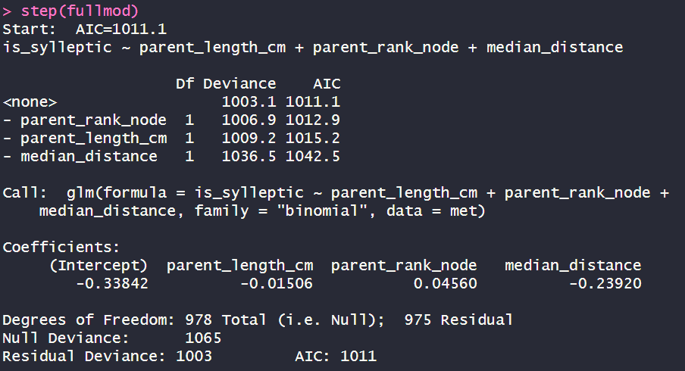
Step()
>fullmod= glm(Y~A+B+C)
>summary(fullmod)→ in questo modo vedi i risultati in termini di Estimate (probabilità, significatività (***) e l’ AIC (più piccolo è meglio è)
Inserendo Mod nella funzione step accade questo:
>step(fullmod)
1. AIC di partenza con tutti e tre i parametri
2. Se il modello mantiene tutti e tre i parametri. L’AIC è 1011.1
3. Se il modello toglie «parent_rank_node». L’AIC è 1012.9 quindi più alto e quindi peggiore
4. Se il modello toglie «parent_length_cm». L’AIC è 1015.2 quindi più alto e quindi peggiore
5. Se il modello toglie «median_distance». L’AIC è 1042.5 quindi più alto e quindi peggiore
Quindi in sostanza, quello con tutti e tre i parametri è il migliore!!

Slide 16
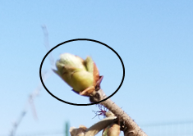
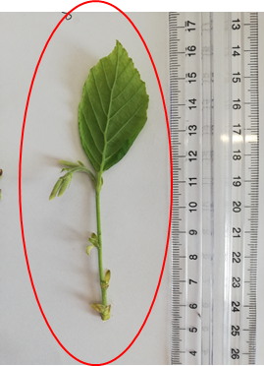

First approach to modelling
Box0:
How many nodes in that shoot
Box1:
Does that rank bear a sylleptic?
NO
Box1.0: how many buds?
YES
Box2: Existence of B (0,1)?
Box2: how many V and M buds?
Box3: proportion of V?
Box3: proportion of V ?
Box4: do you burst?
Box:3.1Proportion of M?
Box:3.1Proportion of M?
Box4: do you burst?
Box5: How many nodes OF NEW SHOOTS?
Box5: How many nodes OF NEW SHOOTS?

Slide 17
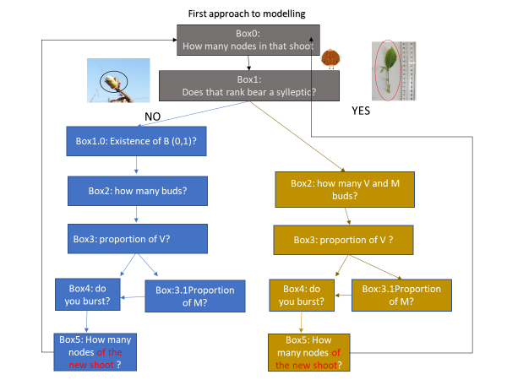
Box0:
How many nodes in that shoot
Is missing the info regarding length distributio:
Acquisition of data in summer 2022

Slide 18
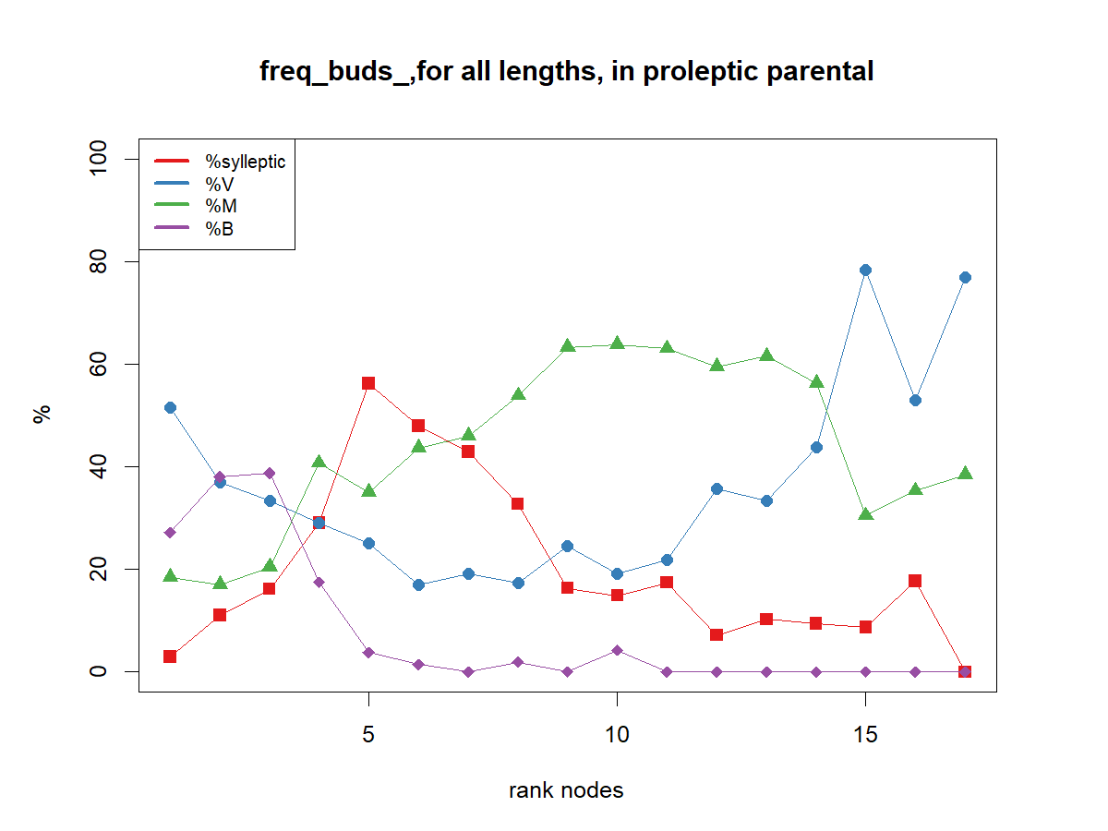
Because sylleptic are distributed in the median zone along the parent shoot, the rank does not have a linear effect:
we compute for each bud the distance to the shoot extremities,
0 is the median rank of each shoot

Slide 19
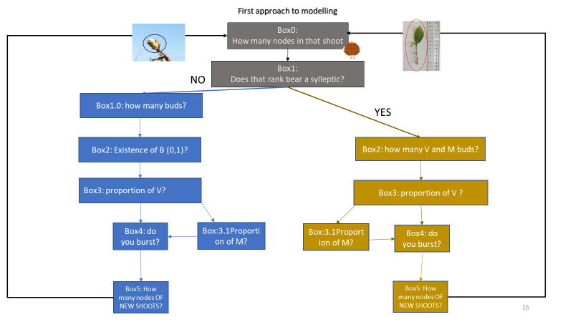
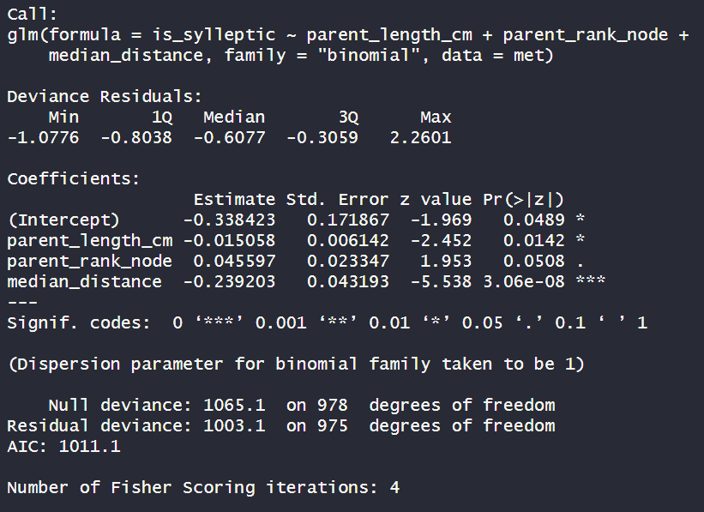
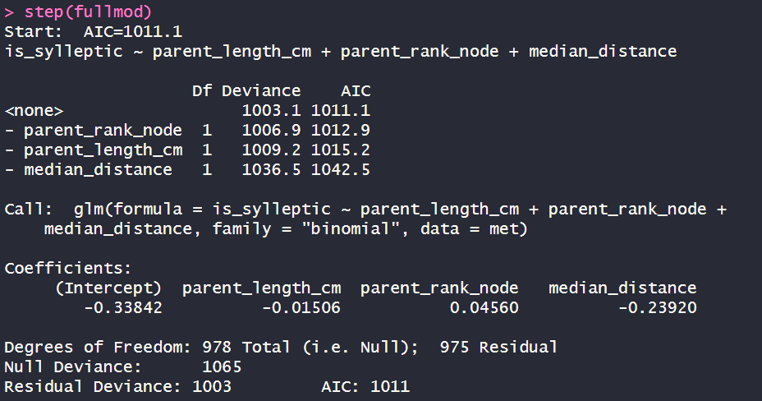
Box1: Does that rank bear a sylleptic?
~length(cm)+rank_node+distance
Length significant(*). Coef=-0.01
Rank node is not significant
Distance is significant (***). Coef=-0.23
AIC=1011.1
It seems to be the best model. Also confirmed by STEP

Slide 20
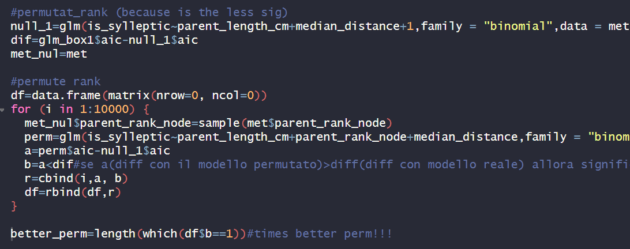
Box1:Does that rank bear a sylleptic?
Permuting
rank node
497 times out of 10000 the aic of null model- aic of permutated ones was greater than the difference with real model (~5%)
because the probability that rank node explain by chance the model is ~5% (>1% of significance) we remove rank node from the equation

Slide 21
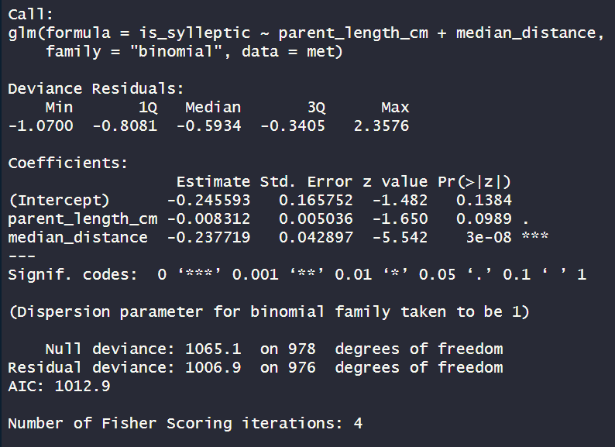
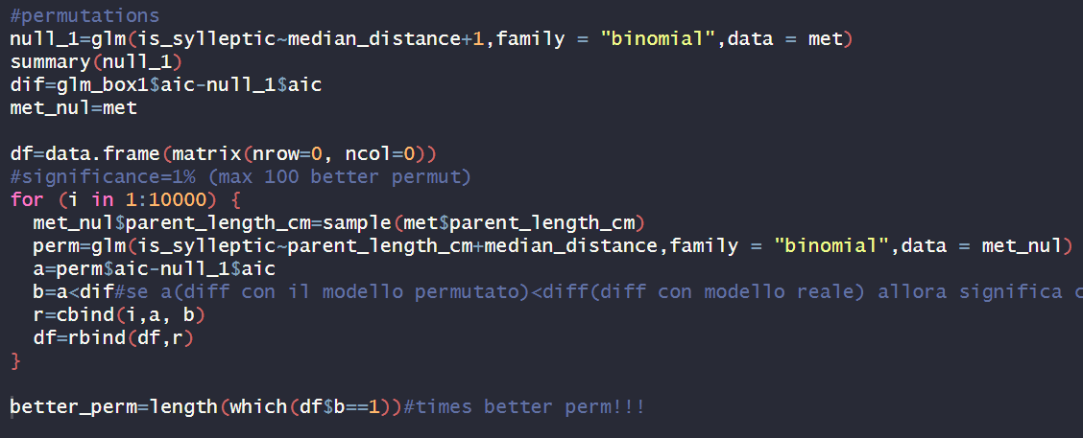
Box1:Does that rank bear a sylleptic?
~parental_length(cm)+distance
Length is not significant
distance is significant(***).Coef=-0.23
AIC=1012.9
AIC WORSE AND PERMUTATION WORSE THAN PREVIOUS
1006 times out of 10000 the aic of null model- aic of permutated ones was greater than the difference with real model!!! ~ 10%
because the probability that LENGTH explain by chance the model is ~10% (>1% of significance) we remove length from the equation

Slide 22
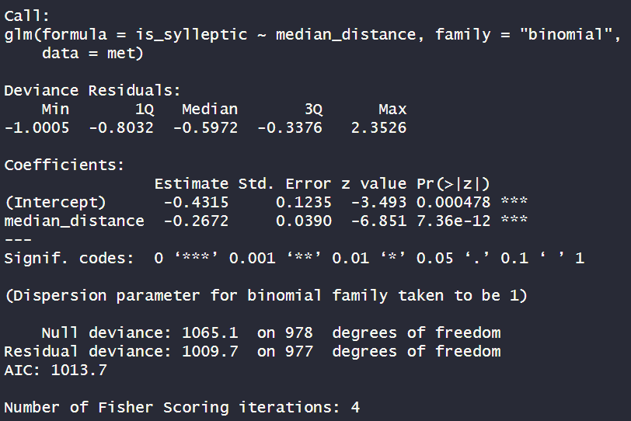
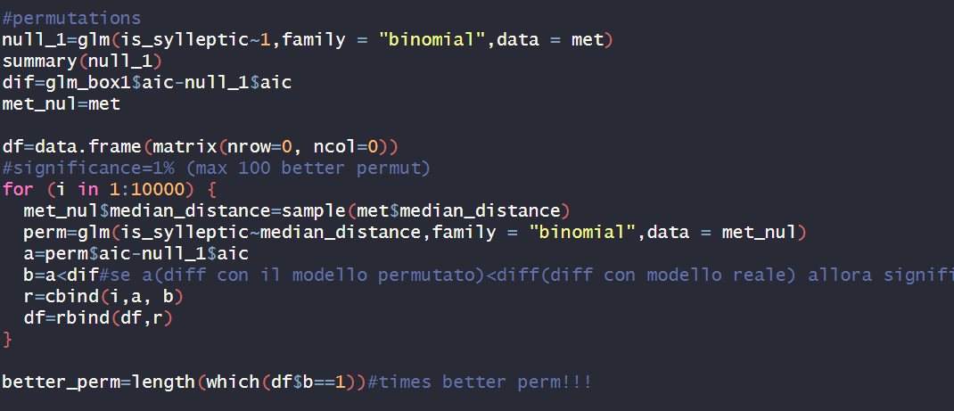
Box1:Does that rank bear a sylleptic?
~distance
distance is significant(***).Coef=-0.27
AIC=1013.7
AIC WORSE BUT PERMUTATION BETTER THAN PREVIOUS
0 times out of 10000 the aic of null model- aic of permutated ones was greater than the difference with real model!!! ~ 0%

Slide 23
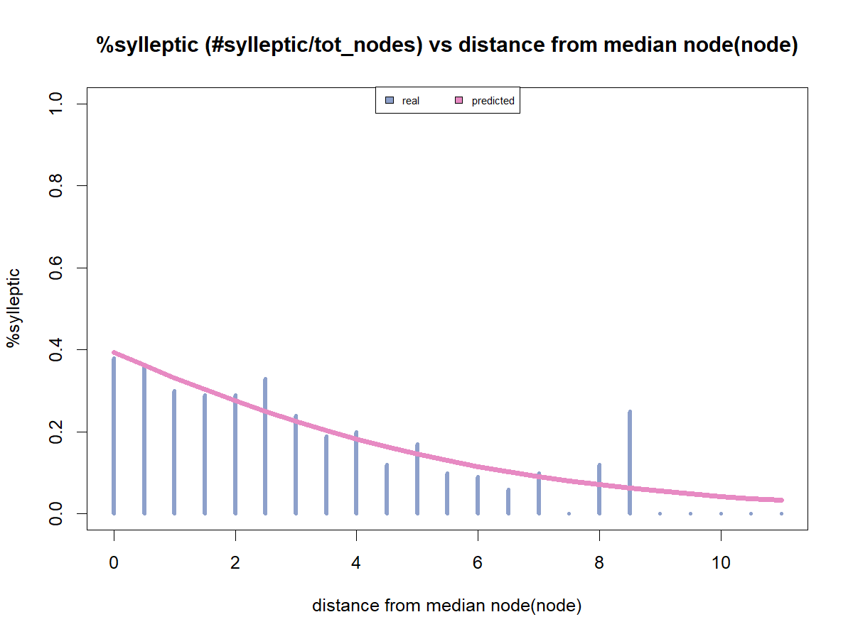

Slide 24
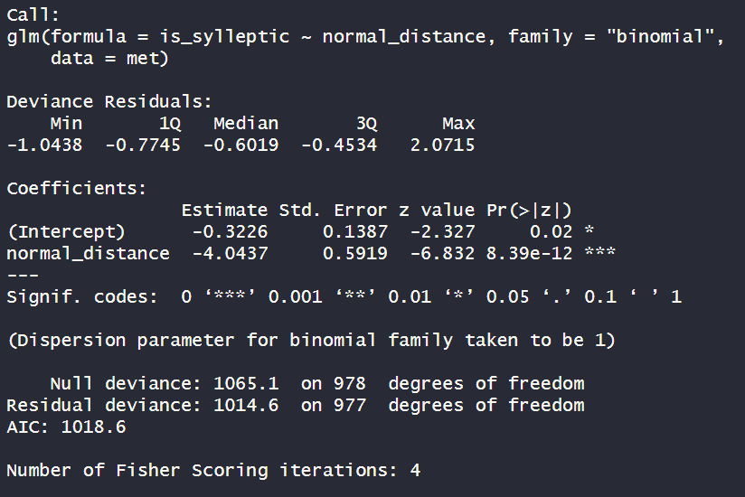
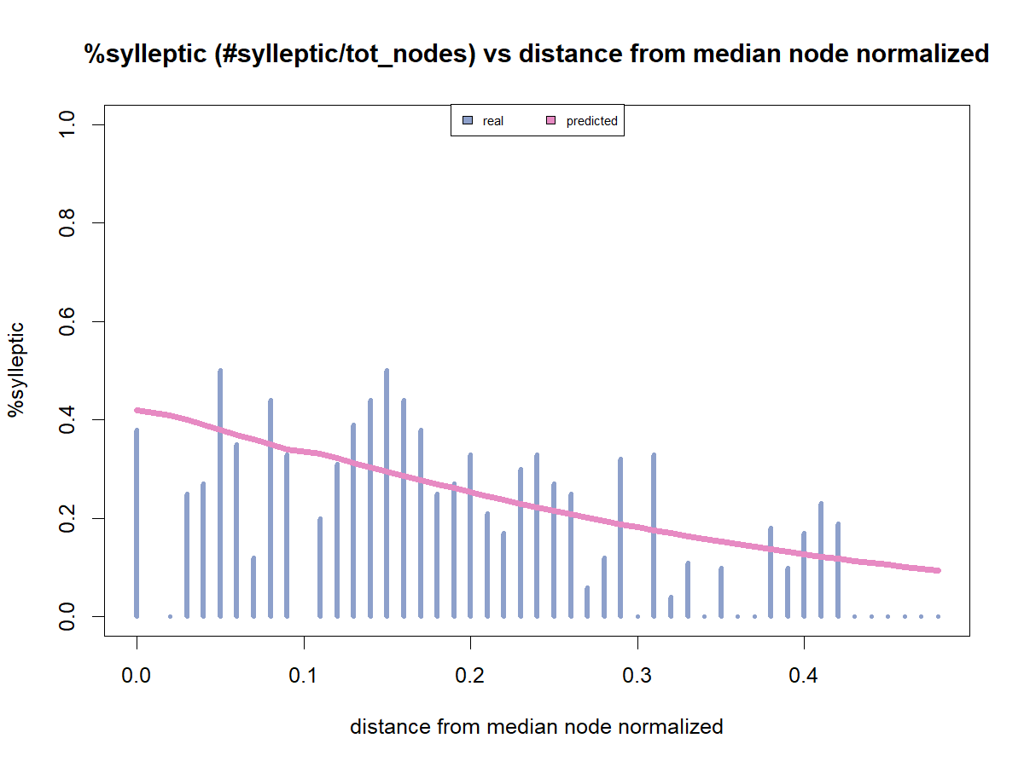
Box1:Does that rank bear a sylleptic?
~distance normalized (distance/tot nodes)
distance is significant(***).Coef=-4.04
AIC WORSE
AIC=1013.7
0=median part
0.5=end/beginning

Slide 25
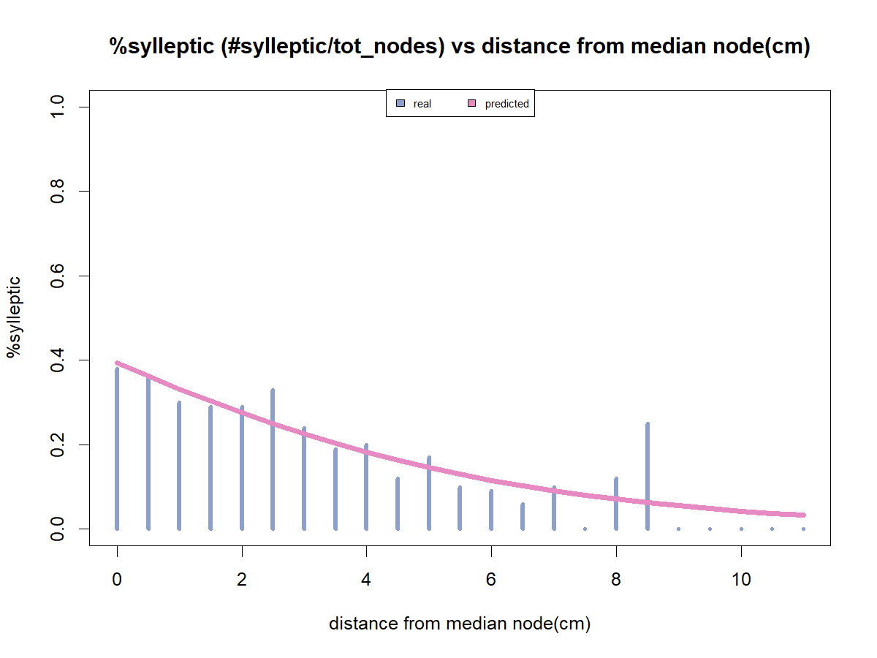
First approach to modelling
Box0:
How many nodes in that shoot
~Distance
Box1:
Does that rank bear a sylleptic?
NO
Box1.0: how many buds?
YES
Box2: Existence of B (0,1)?
Box2: how many V and M buds?
Box3: proportion of V?
Box3: proportion of V ?
Box4: do you burst?
Box:3.1Proportion of M?
Box:3.1Proportion of M?
Box4: do you burst?
Box5: How many nodes OF NEW SHOOTS?
Box5: How many nodes OF NEW SHOOTS?

Slide 26
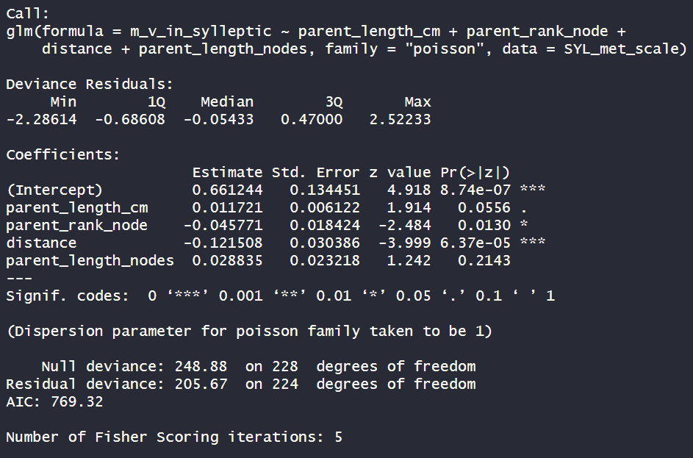
Box2: how many V and M buds?
~parent shoot length(cm)+rank+distance+length(node)
Length is not significant;
Rank is significant(*).Coef=-0.05
Distance is significant(***).Coef=-0.12
Length(node) is not significant
I would remove parent length(node) because is not significant
AIC=769.32

Slide 27
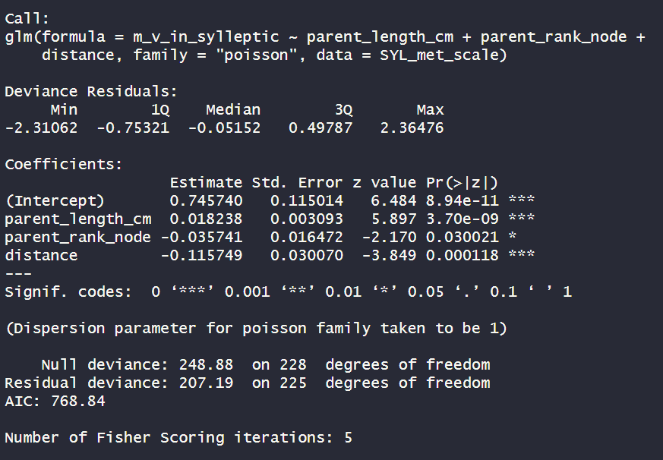
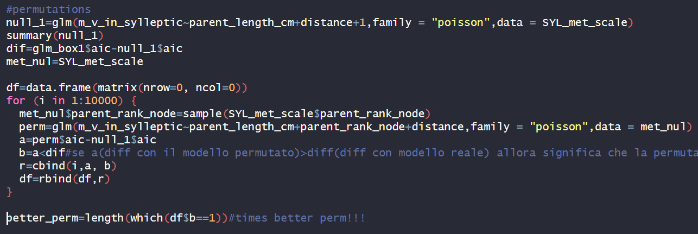
Box2: how many V and M buds?
~parent shoot length(cm)+rank+distance
Length is significant(***).Coef=0.02
Rank is significant(*).Coef=-0.04
Distance is significant(***).Coef=-0.12
Permute rank_node
AIC=768.84
AIC BETTER
120 times out of 10000 the aic of null model- aic of permutated ones was greater than the difference with real model!!! ~ 1.2%
because the probability that RANK explain by chance the model is ~1.2% (>1% of significance) we remove RANK from the equation

Slide 28
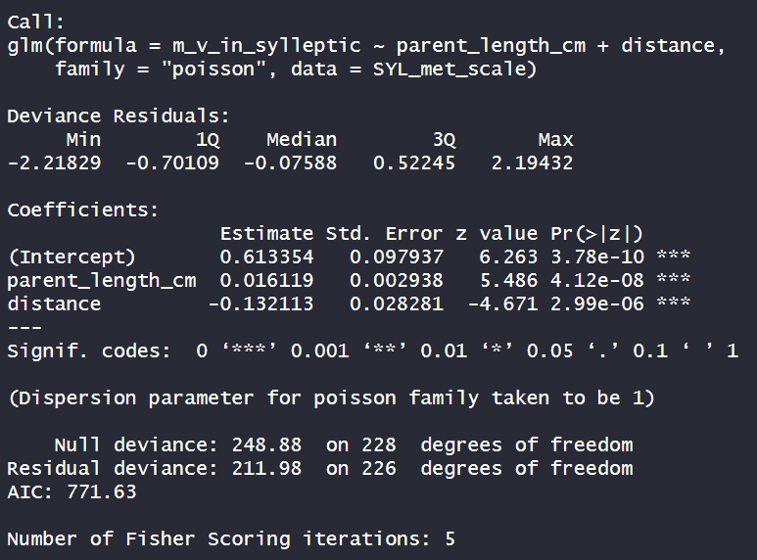
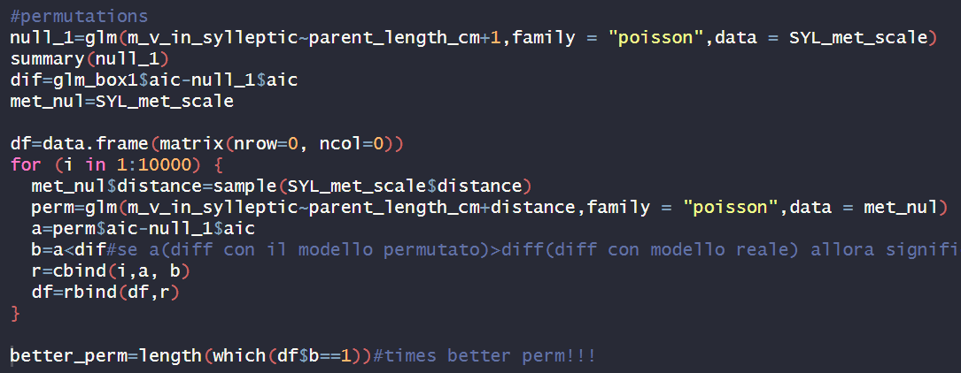
Box2: how many V and M buds?
~parent shoot length(cm)+distance
Length is significant(***).Coef=0.02
Distance is significant(***).Coef=-0.13
Permute DISTANCE
AIC=771.63
AIC WORSE BUT PERMUTATION BETTER
0 times out of 10000 the aic of null model- aic of permutated ones was greater than the difference with real model!!! ~ 0%

Slide 29
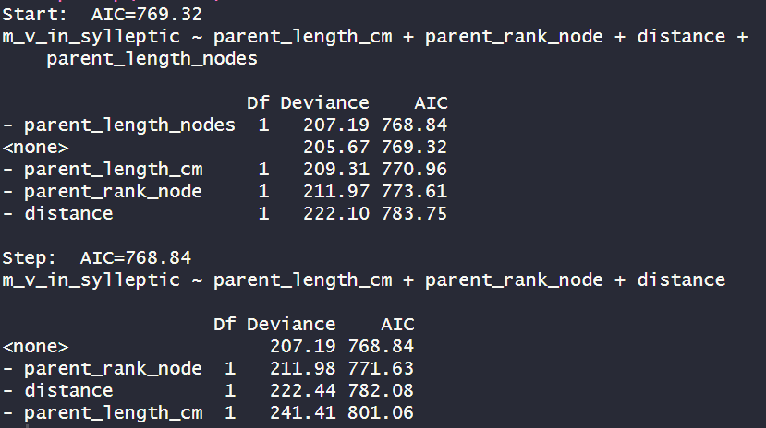
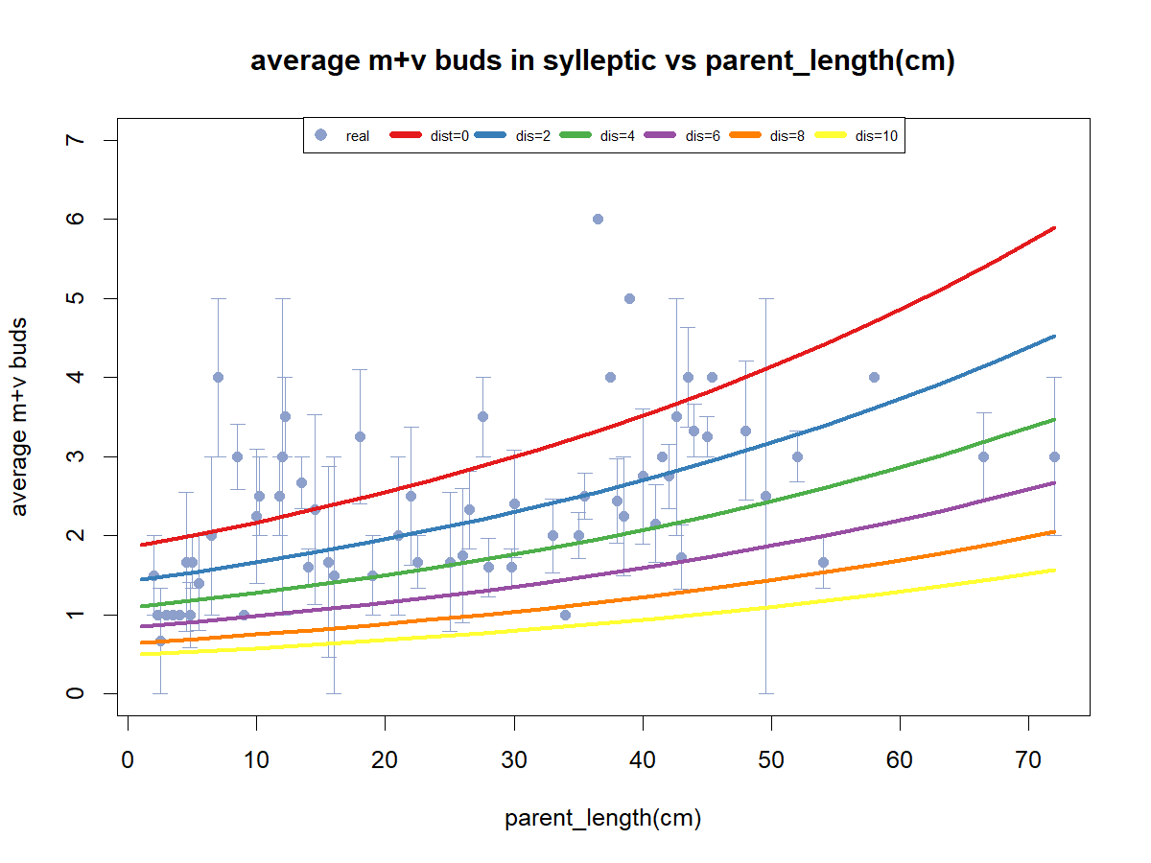
Even though the step model suggest to include the rank node, i will exlude that because it is related to parent_length_cm
Question: why the model says the m+v buds are related to parent lenght? From the picture (the blue dots) seems not

Slide 30
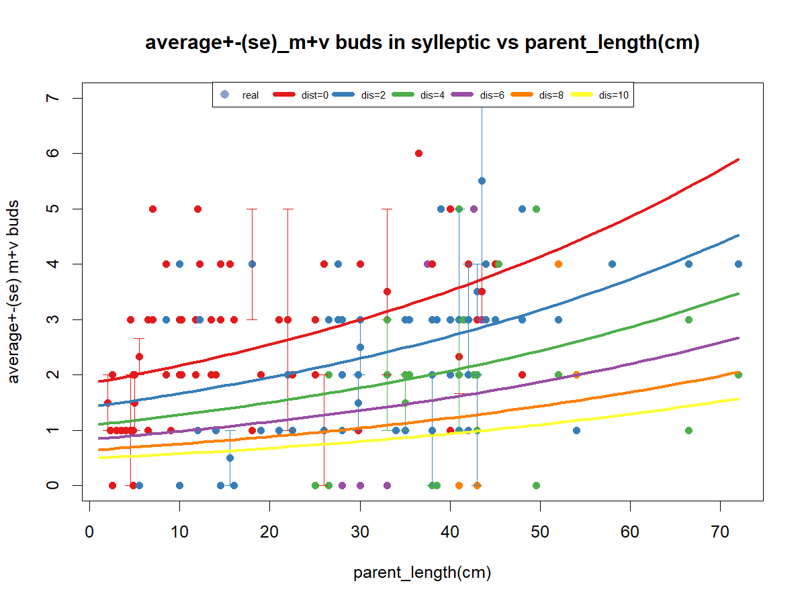
Distance from the median node

Slide 31
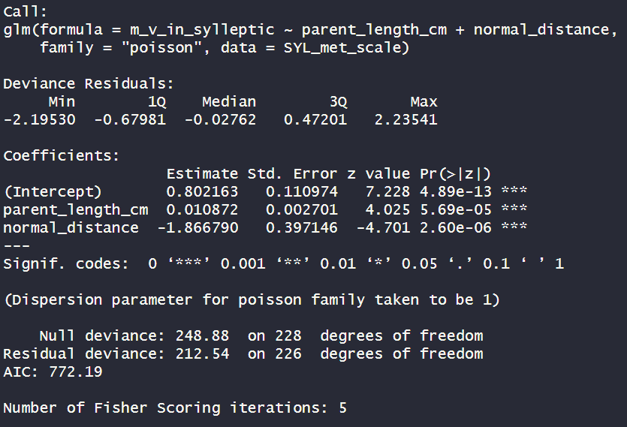
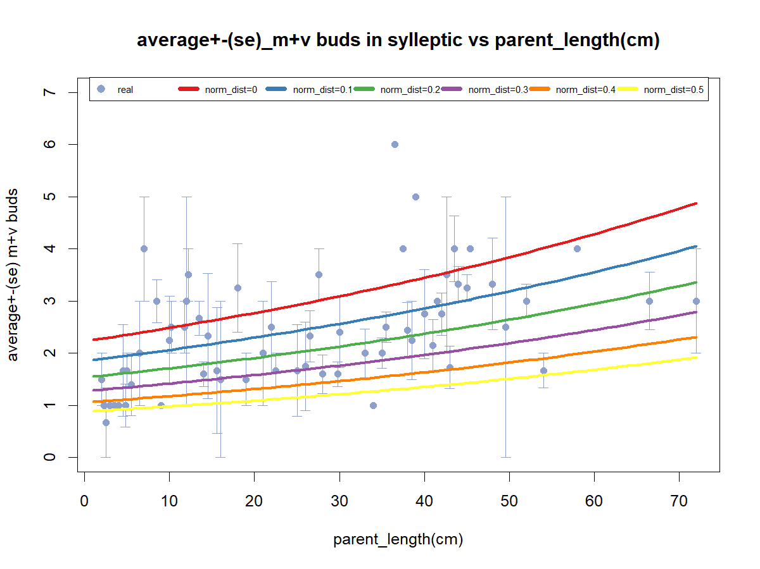
Box2: how many V and M buds?
~parent shoot length(cm)+ nodrmal distance
Length is significant(***).Coef=0.01
Distance is significant(***).Coef=-1.9
AIC=772.19
AIC WORSE

Slide 32
First approach to modelling
Box0:
How many nodes in that shoot
~Distance
Box1:
Does that rank bear a sylleptic?
NO
Box1.0: how many buds?
YES
~length_cm+Distance
Box2: Existence of B (0,1)?
Box2: how many V and M buds?
Box3: proportion of V?
Box3: proportion of V ?
Box4: do you burst?
Box:3.1Proportion of M?
Box:3.1Proportion of M?
Box4: do you burst?
Box5: How many nodes OF NEW SHOOTS?
Box5: How many nodes OF NEW SHOOTS?

Slide 33
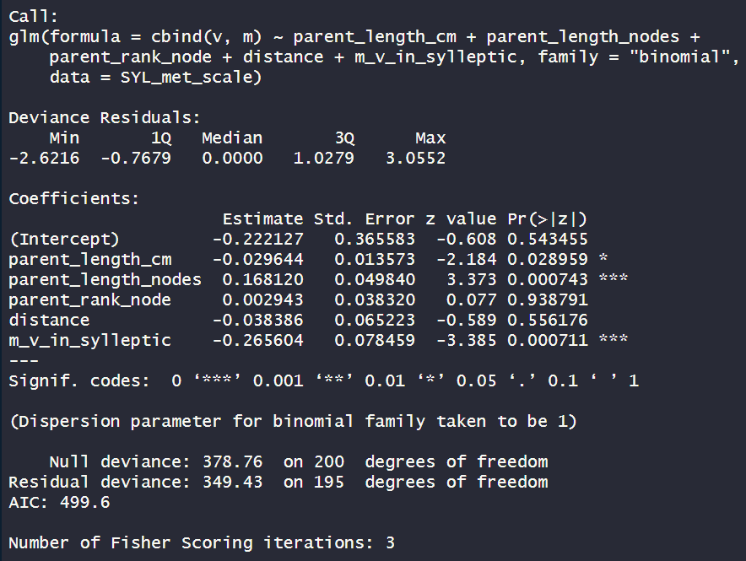
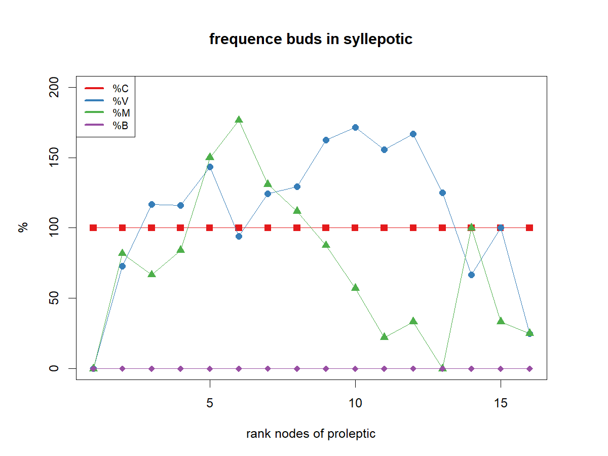
Box3: proportion of V ?
~length(cm)+length(node)+rank node+distance+m_v
Length (cm)is significant(*). Coef=-0.03
Length(nodes) is significant(***). Coef=0.17
Rank is not significant
Distance is not significant
M_v is significant (***). Coef=-0.26
I remove from the model rank
In the pic above it seems that parent rank node has an effect but actually not
AIC=499.6

Slide 34
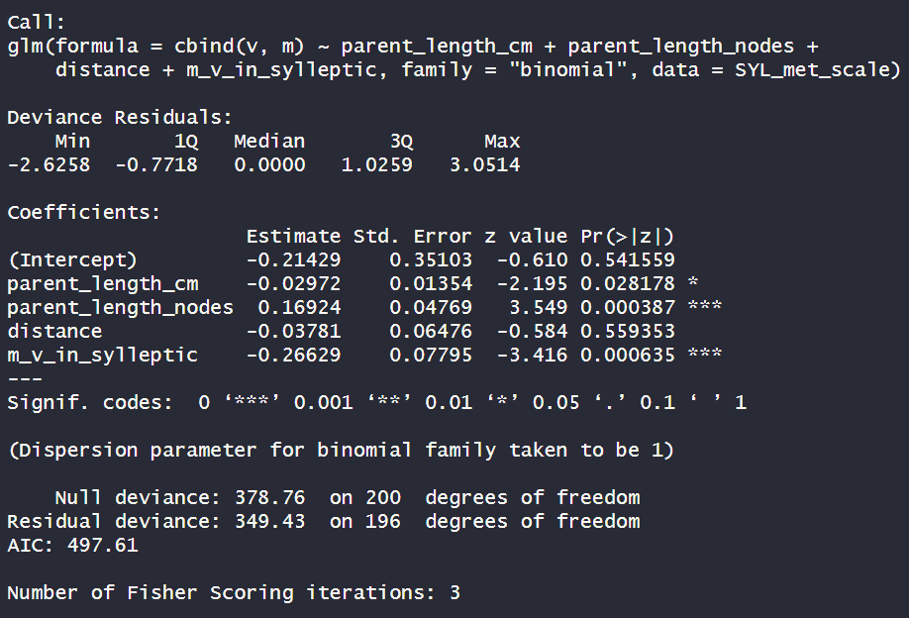
Box3: proportion of V ?
~length(cm)+length(node)+distance+m_v
Length (cm)is significant(*). Coef=-0.03
Length(nodes) is significant(***). Coef=0.17
Distance is not significant
M_v is significant(***).Coef= -0.27
I remove from the model distance
AIC=497.61
AIC BETTER

Slide 35
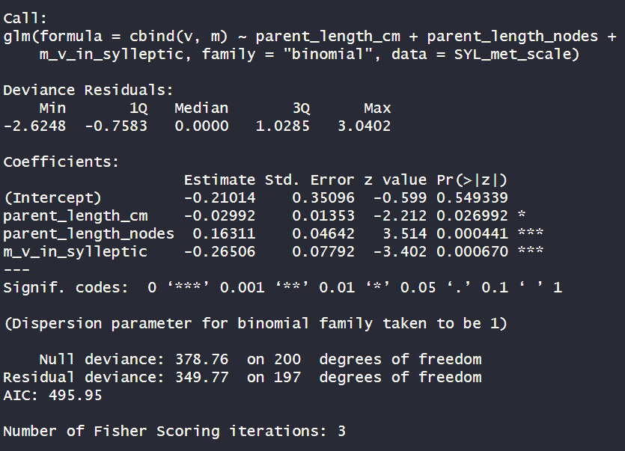
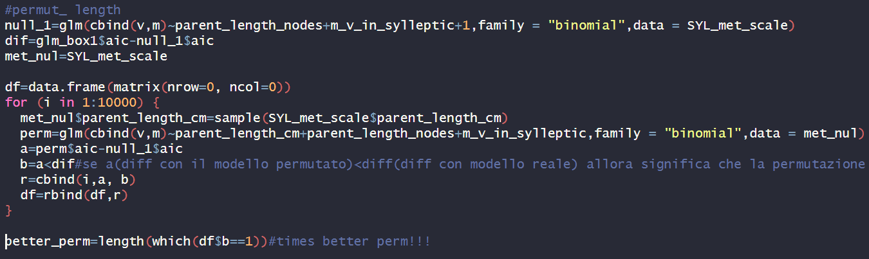
Box3: proportion of V ?
~length(cm)+length(node)+m_v
Length (cm)is significant(**). Coef=-0.03
Length(nodes) is significant(***). Coef=0.17
M_b is significant(***).Coef=-0.27
Permute length(cm)
AIC=495.95
AIC BETTER
764 times out of 10000 the aic of null model- aic of permutated ones was greater than the difference with real model!!! ~ 8%
because the probability that LENGTH explain by chance the model is ~8% (>1% of significance) we remove length from the equation

Slide 36
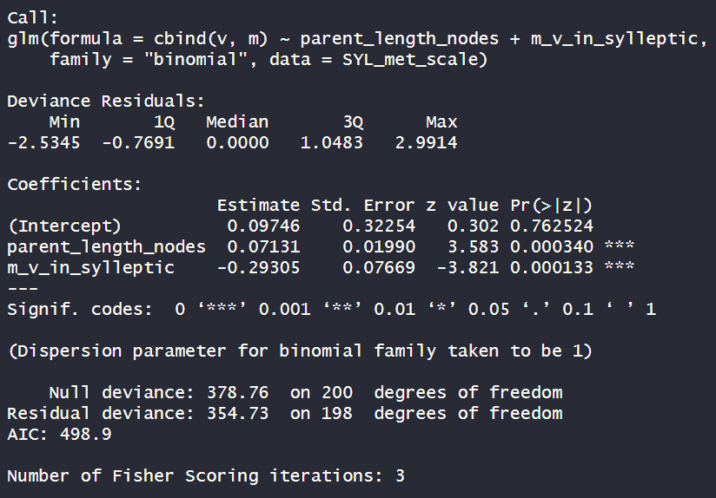
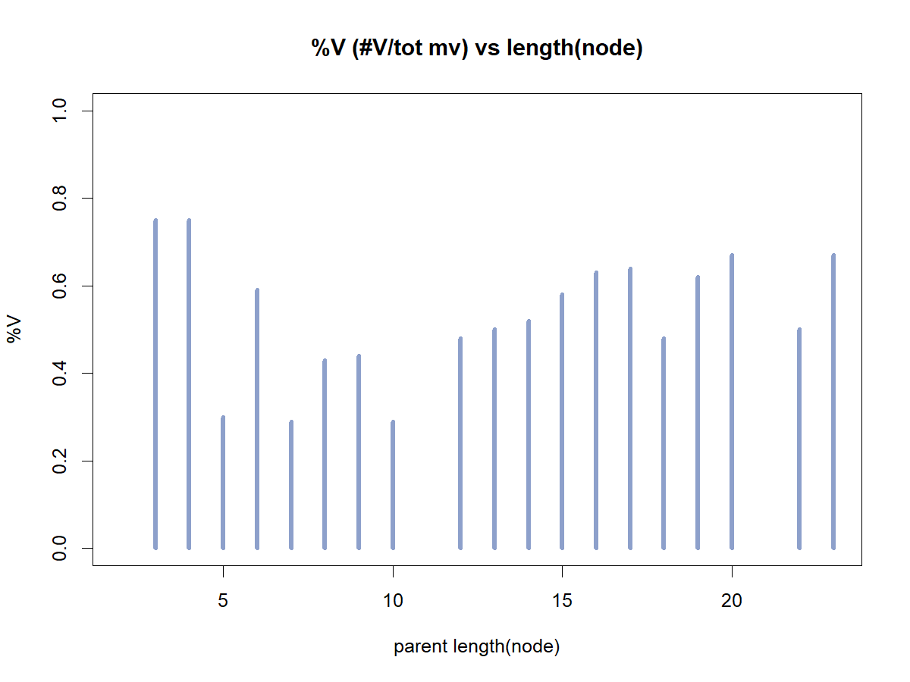
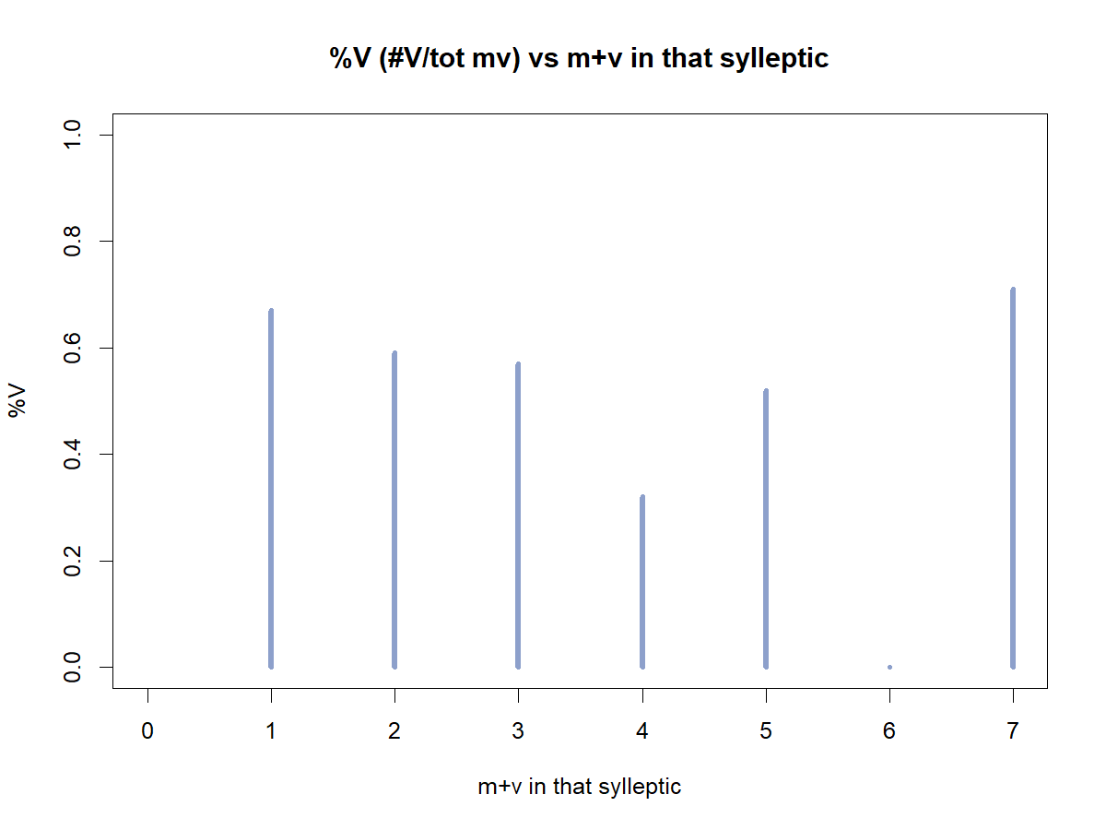
Box3: proportion of V ?
~length(node)+m_v
Length(nodes) is significant(***). Coef=0.07
M_b is significant(***).Coef=-0.29
AIC=498.9
AIC WORSE

Slide 37
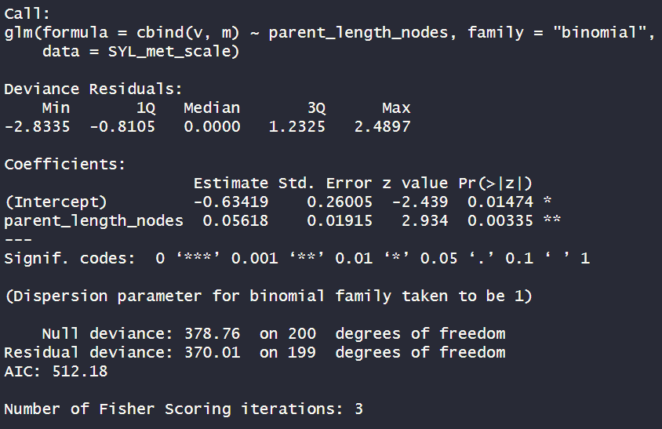

Box3: proportion of V ?
~ length(node)
Length(nodes) is significant(**). Coef=0.05
Permute length(NODE)
AIC=512.18
AIC WORSE
168 times out of 10000 the aic of null model- aic of permutated ones was greater than the difference with real model!!! ~ 1.7%
because the probability that LENGTH explain by chance the model is ~1.7% (>1% of significance) we remove length from the equation

Slide 38


Box3: proportion of V ?
~ length(node)
Actually, because length(node) is PARENT length, we will keep proportion of V in sylleptic as a constant (0.55±0.02)
M+v somma?

Slide 39
First approach to modelling
Box0:
How many nodes in that shoot
~Distance
Box1:
Does that rank bear a sylleptic?
NO
Box1.0: how many buds?
YES
~length_cm+Distance
Box2: Existence of B (0,1)?
Box2: how many V and M buds?
V=constant: (0.55±0.02)
Box3: proportion of V?
Box3: proportion of V ?
M=constant: 1-(0.55±0.02)
Box4: do you burst?
Box:3.1Proportion of M?
Box:3.1Proportion of M?
Box4: do you burst?
Box5: How many nodes OF NEW SHOOTS?
Box5: How many nodes OF NEW SHOOTS?

Slide 40

From M+V
Box4: do you burst?
~fate+fate*length(cm)+ fate* length(nodes)+ fate* distance+ fate* rank+ fate* m+ fate* v
New shoots (1=present, 0=absent), from V buds, related to parent length in sylleptic shoots
Fate1=M
Fate0=v
I remove from the model LENGTH_NODE
AIC=670.81

Slide 41

From M+V
Box4: do you burst?
~fate+fate*length(cm)+ fate* distance+ fate* rank+ fate* m+ fate* v
New shoots (1=present, 0=absent), from V buds, related to parent length in sylleptic shoots
Fate1=M
Fate0=v
I remove from the model rank
AIC=666.83

Slide 42

From M+V
Box4: do you burst?
~fate+fate*length(cm)+ fate* distance+ fate* m+ fate* v
New shoots (1=present, 0=absent), from V buds, related to parent length in sylleptic shoots
Fate1=M
Fate0=v
I remove from the model distance
AIC=666.83

Slide 43

From M+V
Box4: do you burst?
~fate+fate* m+ fate* v
New shoots (1=present, 0=absent), from V buds, related to parent length in sylleptic shoots
Fate1=M
Fate0=v
Explanation of output:
Fate itself (so «I am an M or V») doesn’t affect the fact that the bud bursts;
The fact that there are other M in the same sylleptic doesn’t affect the fact that the bud bursts;
The fact that there are other V in the same sylleptic affects the fact that the bud bursts in a negative way (when V increases, the probability decrease) (***). Coef=-0.64;
The fact that the fate is 1(«I am an M bud») and there are other M in the same syllepytic affects the fact that the bud burst in a negative way (*). Coef=-0.45
The fact that the fate is 1(«I am a M bud») and there are other V in the same syllepytic doesn’t affect the fact that the bud burst
I WILL CONCLUDE THAT FATE IS NOT AFFECTING THE BURSTING OF BUDS THUS I WILL KEEP «FROM M» AND «FROM V» SEPARATED
AIC=670.44

Slide 44
From M+V
Box4: do you burst?
~fate+fate* m+ fate* v
New shoots (1=present, 0=absent), from V buds, related to parent length in sylleptic shoots
Fate1=M
Fate0=v
graph

Slide 45

From V
Box4: do you burst?
~length(cm)+length(nodes)+distance+rank+m+v
New shoots (1=present, 0=absent), from V buds, related to parent length in sylleptic shoots
Length(cm) is not significant;
Lenth(node) is not significant;
Rank node is not significant
Distance is not significant
M is not significant
V is significant(***). Coef=-0.74
I remove from the model LENGTH_NODE
AIC=348.31

Slide 46

From V
Box4: do you burst?
~length(cm)+distance+rank+m+v
New shoots (1=present, 0=absent), from V buds, related to parent length in sylleptic shoots
Length(cm) is significant(*).Coef=0.02
Rank node is not significant
Distance is not significant
M is not significant
V is significant(***). Coef=-0.74
I remove from the model rank
AIC=346.31
AIC BETTER

Slide 47

From V
Box4: do you burst?
~length(cm)+distance+m+v
New shoots (1=present, 0=absent), from V buds, related to parent length in sylleptic shoots
Length(cm) is significant(*).Coef=0.02
Distance is not significant;
M is not significant
V is significant(***). Coef=-0.72
I remove from the model distance
AIC=344.5
AIC BETTER

Slide 48


From V
Box4: do you burst?
~length(cm)+m+v
New shoots (1=present, 0=absent), from V buds, related to parent length in sylleptic shoots
Length(cm) is significant(*).Coef=0.02
M is not significant
V is significant(***). Coef=-0.72
Permute M
651 times out of 10000 the aic of null model- aic of permutated ones was greater than the difference with real model!!! ~ 6.5%
AIC=344.5
AIC BETTER
because the probability that M explain by chance the model is ~6.5% (>1% of significance) we remove M from the equation

Slide 49


From V
Box4: do you burst?
~length(cm)+v
New shoots (1=present, 0=absent), from V buds, related to parent length in sylleptic shoots
Length(cm) is significant(*).Coef=0.02
V is significant(***). Coef=-0.65
Permute LENGTH
496 times out of 10000 the aic of null model- aic of permutated ones was greater than the difference with real model!!! ~ 5%
AIC=344.8
AIC WORSE
because the probability that length explain by chance the model is ~5% (>1% of significance) we remove length from the equation

Slide 50


From V
Box4: do you burst?
~v
New shoots (1=present, 0=absent), from V buds, related to parent length in sylleptic shoots
V is significant(***). Coef=-0.6
Permute V
0 times out of 10000 the aic of null model- aic of permutated ones was greater than the difference with real model!!! ~ 0%
AIC=346.8
AIC WORSE

Slide 51


Even though the step model suggest to include the m and length, i will exlude that because permutations showed more than 1% of random effect

Slide 52
First approach to modelling
Box0:
How many nodes in that shoot
~Distance
Box1:
Does that rank bear a sylleptic?
NO
Box1.0: how many buds?
YES
~length_cm+Distance
Box2: Existence of B (0,1)?
Box2: how many V and M buds?
V=constant: (0.55±0.02)
Box3: proportion of V?
Box3: proportion of V ?
M=constant: 1-(0.55±0.02)
ifV:~V
Box4: do you burst?
Box:3.1Proportion of M?
Box:3.1Proportion of M?
Box4: do you burst?
Box5: How many nodes OF NEW SHOOTS?
Box5: How many nodes OF NEW SHOOTS?

Slide 53

From M
Box4: do you burst?
~length(cm)+length(nodes)+distance+rank+m+v
New shoots (1=present, 0=absent), from M buds, related to parent length in sylleptic shoots
Length(cm) is not significant;
Lenth(node) is not significant;
Rank node is not significant
Distance is significant (*).Coef=-0.28
M significant(***).Coef=-0.7
V is significant(*). Coef=-0.32
I remove from the model LENGTH_NODE
AIC=322.51

Slide 54

From M
Box4: do you burst?
~length(cm)+distance+rank+m+v
New shoots (1=present, 0=absent), from M buds, related to parent length in sylleptic shoots
Length(cm) is significant(*). Coef=0.02;
Rank node is not significant
Distance is significant (**).Coef=-0.28
M significant(***).Coef=-0.7
V is significant(*). Coef=-0.32
I remove from the model rank
AIC=320.52
AIC BETTER

Slide 55


From M
Box4: do you burst?
~length(cm)+distance+m+v
New shoots (1=present, 0=absent), from M buds, related to parent length in sylleptic shoots
Length(cm) is significant(*). Coef=0.02;
Distance is significant (**).Coef=-0.28
M significant(***).Coef=-0.7
V is significant(*). Coef=-0.32
PERMUTE V
417 times out of 10000 the aic of null model- aic of permutated ones was greater than the difference with real model!!! ~ 4%
AIC=318.54
AIC BETTER
because the probability that length explain by chance the model is ~4% (>1% of significance) we remove v from the equation

Slide 56


From M
Box4: do you burst?
~length(cm)+distance+m
New shoots (1=present, 0=absent), from M buds, related to parent length in sylleptic shoots
Length(cm) is not significant;
Distance is significant (**).Coef=-0.28
M significant(***).Coef=-0.6
PERMUTE length
736 times out of 10000 the aic of null model- aic of permutated ones was greater than the difference with real model!!! ~ 7%
AIC=320.71
AIC WORSE
because the probability that length explain by chance the model is ~7% (>1% of significance) we remove length from the equation

Slide 57


From M
Box4: do you burst?
~ distance+m
New shoots (1=present, 0=absent), from M buds, related to parent length in sylleptic shoots
Distance is significant (*).Coef=-0.2
M significant(***).Coef=-0.6
PERMUTE distance
287 times out of 10000 the aic of null model- aic of permutated ones was greater than the difference with real model!!! ~ 3%
AIC=321.71
AIC WORSE
because the probability that length explain by chance the model is ~3% (>1% of significance) we remove distance from the equation

Slide 58


From M
Box4: do you burst?
~ m
New shoots (1=present, 0=absent), from M buds, related to parent length in sylleptic shoots
M significant(***).Coef=-0.6
PERMUTE M
0 times out of 10000 the aic of null model- aic of permutated ones was greater than the difference with real model!!! ~ 0%
AIC=324.81
AIC WORSE

Slide 59


Even though the step model suggest to include the v and length,and distance i will exlude that because permutations showed more than 1% of random effect

Slide 60
First approach to modelling
Box0:
How many nodes in that shoot
~Distance
Box1:
Does that rank bear a sylleptic?
NO
Box1.0: how many buds?
YES
~length_cm+Distance
Box2: Existence of B (0,1)?
Box2: how many V and M buds?
V=constant: (0.55±0.02)
Box3: proportion of V?
Box3: proportion of V ?
M=constant: 1-(0.55±0.02)
ifV:~V
Box4: do you burst?
Box:3.1Proportion of M?
Box:3.1Proportion of M?
Box4: do you burst?
ifM:~M
Box5: How many nodes OF NEW SHOOTS?
Box5: How many nodes OF NEW SHOOTS?

Slide 61



Slide 62
Interpret:
The base is «Beeing a V»;
When length_cm increase of 1 unit %B vs %V decrease ot 0.07;
When distance increase of 1 unit %B vs %V decrease or 0.83;
When rank_node increase of 1 unit %B vs %V decrease of 1.01;
When length_node increase of 1 unit %B vs %V increase of 0.57;
When length_cm increase of 1 unit %M vs %V increase of 0.006;
When distance increase of 1 unit %M vs %V decrease of 0.30;
When rank_node increase of 1 unit %M vs %V increase of 0.05;
When length_node increase of 1 unit %M vs %V increase of 0.01;

Slide 63


Box2: how many buds?
Tot_buds(m+v+b)~shoot length(cm)+rank node+distance+ length(node)
NO SIGNIFICANCE AT ALL

Slide 64

Box2: how many buds?
~shoot length(cm)+rank node+distance+ length(node)
Length is significant(*). Coef=+0.01
Distance is significant(*).Coef=-0.04
Rank_node is significant(**).Coef=0.03
Parent:length node is not significant
I would remove parent length(node) because is not significant
AIC=1603.2

Slide 65


Box2: how many buds?
~shoot length(cm)+rank+distance
Length is significant(*). Coef=+0.0076
Distance is significant(**).Coef=*0.05
Rank is significant(**).Coef=0.02
I would permute length (cm)
AIC=1603.1 is lower than previous
5 times out of 10000 the aic of null model- aic of permutated ones was greater than the difference with real model!!! ~ 0.05%

Slide 66



Box2: how many buds?

Slide 67



Box2: how many buds?
~shoot length(cm)+rank+distance
because it seems that <rank5 there are not m+v and after they start i make the analysis <5 and >5:
Rank <5=0
Rank >5=1

Slide 68
First approach to modelling
Box0:
How many nodes in that shoot
~Distance
Box1:
Does that rank bear a sylleptic?
NO
~rank < or >5
Box1.0: how many buds?
YES
~length_cm+Distance
Box2: Existence of B (0,1)?
Box2: how many V and M buds?
V=constant: (0.55±0.02)
Box3: proportion of V?
Box3: proportion of V ?
M=constant: 1-(0.55±0.02)
ifV:~V
Box4: do you burst?
Box:3.1Proportion of M?
Box:3.1Proportion of M?
Box4: do you burst?
ifM:~M
Box5: How many nodes OF NEW SHOOTS?
Box5: How many nodes OF NEW SHOOTS?

Slide 69


Box2.0: Existence of B (0,1)?
~shoot length(cm)+rank node+distance + length(node)
Length(cm) is significant(***). Coef=-0.07
RANK is significant (**). Coef=-1
Distance is significant(*). Coef= -0.7
Length(node) is significant(**). Coef=0.55
PERMUTE Distance
AIC=496.57 is the smallest
19 times out of 10000 the aic of null model- aic of permutated ones was greater than the difference with real model!!! ~ 0.2%
because the probability that length explain by chance the model is ~0.2% (<1% of significance) we keep distance in the equation

Slide 70


Box2.0: Existence of B (0,1)?
~shoot length(cm)+rank node+distance + length(node)
because length_cm and length(nodes) are correlated i would have removed length_node from the glm

Slide 71


Box2.0: Existence of B (0,1)?
~shoot length(cm)+rank node+distance
Length(cm) is not significant
RANK is significant (***). Coef=-0.35
Distance not significant
Remove distance
Remove length
AIC=517.74 is the greater
Length(cm) is not significant
RANK is significant (***). Coef=-0.4
AIC=516.61 is the lower

Slide 72


Box2.0: Existence of B (0,1)?
~rank node
RANK is significant (***). Coef=-0.4
AIC=516.22 is lower
I WILL CHOSE THIS MODEL EVEN THOUGH THE STEP SUGGEST TO KEEP ALL THE PARAMETERS

Slide 73




Box2.0: Existence of B (0,1)?
~shoot length(cm)+rank node+distance + length(node)
Length(cm) is significant(***). Coef=-0.07
RANK is significant (***). Coef=-3.89
Distance is not- ignificant.
Length(node) is significant(***). Coef=0.25
Rank <5=0
Rank >5=1
AIC=490.07 is the smallest

Slide 74

Box2.0: Existence of B (0,1)?
~shoot length(cm)+rank node
Length(cm) is not significant
RANK is significant (***). Coef=-3.89
Rank <5=0
Rank >5=1
Remove length(cm)
AIC=500.21

Slide 75


Box2.0: Existence of B (0,1)?
~rank node
RANK is significant (***). Coef=-3.51
Rank <5=0
Rank >5=1
AIC=500.09

Slide 76
First approach to modelling
Box0:
How many nodes in that shoot
~Distance
Box1:
Does that rank bear a sylleptic?
NO
~rank < or >5
Box1.0: how many buds?
YES
~length_cm+Distance
~rank < or >5
Box2: Existence of B (0,1)?
Box2: how many V and M buds?
V=constant: (0.55±0.02)
Box3: proportion of V?
Box3: proportion of V ?
M=constant: 1-(0.55±0.02)
ifV:~V
Box4: do you burst?
Box:3.1Proportion of M?
Box:3.1Proportion of M?
Box4: do you burst?
ifM:~M
Box5: How many nodes OF NEW SHOOTS?
Box5: How many nodes OF NEW SHOOTS?

Slide 77

Box3: proportion of V?
~length(cm)+length(node)+rank node+distance
Length (cm) is not significant;
Length(nodes) is not significant;
Rank node is significant(**). Coef= -0.05;
Distance is significant(***). Coef=0.30
I would remove parent length(node) because is not significant
AIC=845.41

Slide 78


Box3: proportion of V?
~length(cm)+rank node+distance
Rank node is significant(**). Coef= -0.05;
Distance is significant(***). Coef=0.30
I would remove parent length(cm) because is not significant. Even though STEP( ) says it is the best model
AIC=843.45

Slide 79


Box3: proportion of V?
~rank node+distance

Slide 80


Box3: proportion of V?
~distance
Distance is significant(***). Coef=0.24
AIC=858.31

Slide 81

First approach to modelling
Box0:
How many nodes in that shoot
~Distance
Box1:
Does that rank bear a sylleptic?
NO
~rank < or >5
Box1.0: how many buds?
YES
~length_cm+Distance
~rank < or >5
Box2: Existence of B (0,1)?
Box2: how many V and M buds?
V=~ distance
V=constant: (0.55±0.02)
Box3: proportion of V?
Box3: proportion of V ?
M=constant: 1-(%V)
M=constant: 1-(0.55±0.02)
ifV:~V
Box4: do you burst?
Box:3.1Proportion of M?
Box:3.1Proportion of M?
Box4: do you burst?
ifM:~M
Box5: How many nodes OF NEW SHOOTS?
Box5: How many nodes OF NEW SHOOTS?

Slide 82

From M+V
Box4: do you burst?
~length(cm)+length(nodes)+distance+rank+m+v
New shoots (1=present, 0=absent), from V buds, related to parent length in PROLEPTIC shoots
I remove from the model LENGTH_NODE

Slide 83

From M+V
Box4: do you burst?
~length(cm)+distance+rank+m+v
New shoots (1=present, 0=absent), from V buds, related to parent length in PROLEPTIC shoots
I remove from the model m

Slide 84
From M+V
Box4: do you burst?
~length(cm)+distance+rank+m+v
New shoots (1=present, 0=absent), from V buds, related to parent length in PROLEPTIC shoots
I remove from the model m

Slide 85

From M+V
Box4: do you burst?
~length(cm)+distance+rank+v
New shoots (1=present, 0=absent), from V buds, related to parent length in PROLEPTIC shoots

Slide 86
From M+V
Box4: do you burst?
~length(cm)+distance+rank+v
New shoots (1=present, 0=absent), from V buds, related to parent length in PROLEPTIC shoots

Slide 87

From M+V
Box4: do you burst?
~length(cm)+distance+rank+v
New shoots (1=present, 0=absent), from V buds, related to parent length in PROLEPTIC shoots

Slide 88

From V
Box4: do you burst?
~length(cm)+length(nodes)+distance+rank+m+v
New shoots (1=present, 0=absent), from V buds, related to parent length in PROLEPTIC shoots
Length(cm) is Significant(**).Coef=0.06;
Lenth(node) is not significant;
Rank node is significant(**).Coef=0.08
Distance is significant(***).Coef=-0.4
M is not significant
V is significant(**). Coef=-0.9
I remove from the model LENGTH_NODE
AIC=328.76

Slide 89

From V
Box4: do you burst?
~length(cm)+distance+rank+m+v
New shoots (1=present, 0=absent), from V buds, related to parent length in PROLEPTIC shoots
Length(cm) is Significant(***).Coef=0.05;
Rank node is significant(**).Coef=0.08
Distance is significant(***).Coef=-0.4
M is not significant
V is significant(**). Coef=-0.9
I remove from the model m
AIC=327.06

Slide 90


From V
Box4: do you burst?
~length(cm)+ distance+rank+v
New shoots (1=present, 0=absent), from V buds, related to parent length in PROLEPTIC shoots
Length(cm) is Significant(***).Coef=0.05;
Rank node is significant(**).Coef=0.08
Distance is significant(***).Coef=-0.4
V is significant(**). Coef=-1
Permute rank
25 times out of 10000 the aic of null model- aic of permutated ones was greater than the difference with real model!!! ~ 0.25%
AIC=328.14
How can I make a graph of those 4 predictors?

Slide 91

From V
Box4: do you burst?
~length(cm)+ distance+rank+m+v
New shoots (1=present, 0=absent), from V buds, related to parent length in PROLEPTIC shoots
Step function says that the best model includes also «m». That I removed because it was not significant.
If I also remove rank from the model (because is trhe less significant. Even though permutations showed 0.25% of causal effect)

Slide 92





From V
Box4: do you burst?
~length(cm)+ distance+rank+m+v
New shoots (1=present, 0=absent), from V buds, related to parent length in PROLEPTIC shoots

Slide 93


From V
Box4: do you burst?
~v
New shoots (1=present, 0=absent), from V buds, related to parent length in PROLEPTIC shoots
V is significant(***). Coef=-0.75
AIC=366.44

Slide 94


First approach to modelling
Box0:
How many nodes in that shoot
~Distance
Box1:
Does that rank bear a sylleptic?
~rank node
Box1.0: Existence of B (0,1)?
~length_cm+Distance
~rank node
Box2: how many buds?
Box2: how many V and M buds?
V=~normalized distance
V=constant: (0.55±0.02)
Box3: proportion of V?
Box3: proportion of V ?
M=constant: 1-(%V)
M=constant: 1-(0.55±0.02)
ifV:~V
Box4: do you burst?
Box:3.1Proportion of M?
Box:3.1Proportion of M?
Box4: do you burst?
ifV:~V
ifM:~M
Box5: How many nodes OF NEW SHOOTS?
Box5: How many nodes OF NEW SHOOTS?

Slide 95

From M
Box4: do you burst?
~length(cm)+length(nodes)+distance+rank+m_v
New shoots (1=present, 0=absent), from V buds, related to parent length in PROLEPTIC shoots
Length(cm) is not significant;
Lenth(node) is not significant;
Rank node is significant(**).Coef=0.2
Distance is not significant
M_V is significant(***).Coef=-0.91
I remove from the model distance
AIC=236.03

Slide 96

From M
Box4: do you burst?
~length(cm)+length(nodes)+rank+m_v
New shoots (1=present, 0=absent), from V buds, related to parent length in PROLEPTIC shoots
Length(cm) is not significant;
Lenth(node) is not significant;
Rank node is significant(***).Coef=0.2
M_V is significant(***).Coef=-0.92
I remove from the model length_node
AIC=234.09

Slide 97

From M
Box4: do you burst?
~length(cm)+ rank+m_v
New shoots (1=present, 0=absent), from V buds, related to parent length in PROLEPTIC shoots
Length(cm) is not significant;
Rank node is significant(**).Coef=0.16
M_V is significant(***).Coef=-0.9
I remove from the model length_cm
AIC=234.73

Slide 98


From M
Box4: do you burst?
~ rank+m_v
New shoots (1=present, 0=absent), from V buds, related to parent length in PROLEPTIC shoots
Rank node is significant(**).Coef=0.16
M_V is significant(***).Coef=-0.9
Permute rank
0 times out of 10000 the aic of null model- aic of permutated ones was greater than the difference with real model!!! ~ 0%
AIC=234.07

Slide 99


From M
Box4: do you burst?
~ rank+m+v
New shoots (1=present, 0=absent), from V buds, related to parent length in PROLEPTIC shoots
There is just 1 shoot with 9 buds(4V+5M). Of those 5, just 1 burst (0.2)

Slide 100

From M
Box4: do you burst?
~ rank+m+v
New shoots (1=present, 0=absent), from V buds, related to parent length in PROLEPTIC shoots
There is just 1 shoot with 9 buds(4V+5M). Of those 5, just 1 burst (0.2)

Slide 101

First approach to modelling
Box0:
How many nodes in that shoot
~Distance
Box1:
Does that rank bear a sylleptic?
~rank node
Box1.0: Existence of B (0,1)?
~length_cm+Distance
~rank node
Box2: how many buds?
Box2: how many V and M buds?
V=~normalized distance
V=constant: (0.55±0.02)
Box3: proportion of V?
Box3: proportion of V ?
M=constant: 1-(%V)
M=constant: 1-(0.55±0.02)
ifV:~V
Box4: do you burst?
Box:3.1Proportion of M?
Box:3.1Proportion of M?
Box4: do you burst?
ifV:~V
ifM:~rank node+m_v
ifM:~M
Box5: How many nodes OF NEW SHOOTS?
Box5: How many nodes OF NEW SHOOTS?

